Slide 1
Know Your H2O Our Vision of “Change”
Integrating water management:
GOALS:
Water supply reliability, pollution prevention, watershed restoration, habitat creation/restoration, Embedded Energy REDUCTION, etc
Solutions require both changes in personal behavior and social norms, as well as holistic integration &/or reform of laws, regulations, funding priorities & public programs

Slide 2
Vision, Public Education, Action
“The Cycle of Insanity: The Real Story of Water” – our effort at public education and vision of reform
Ocean Friendly Gardens – our effort at changing social norms through landscape design changes
Advocacy: Replacing imported water with multi-benefit local alternatives (wastewater recycling, LID, “green streets”, created/restored wetland networks,
Long-term: capturing enough water in urban landscapes to start removing impervious flood control projects – Urban Watershed Restoration

Slide 3
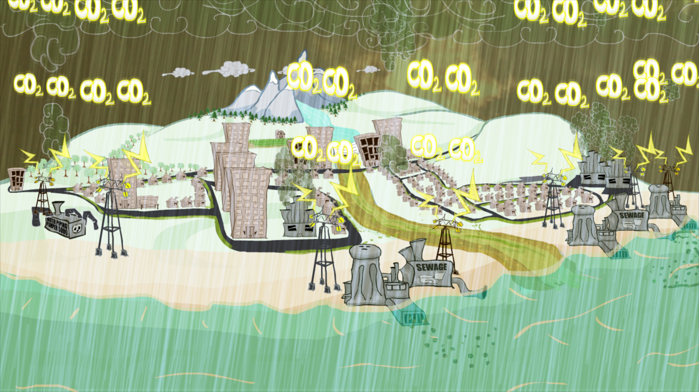
Cycle of Insanity: The Real Story of Water Natural Water Cycle vs Mismanagement

Slide 4
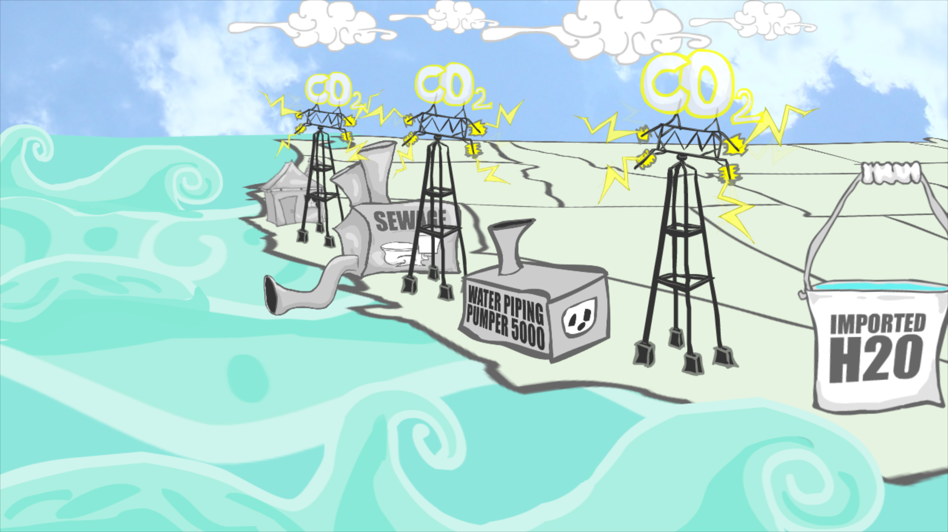
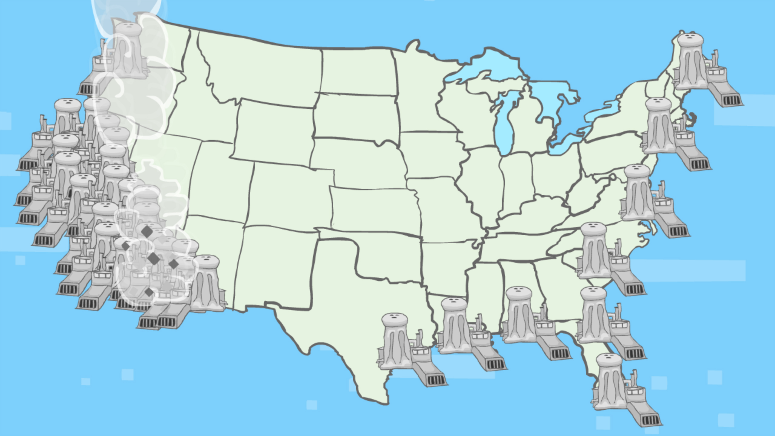
Cycle of Insanity: The Real Story of Water Water = Energy Demand

Slide 5
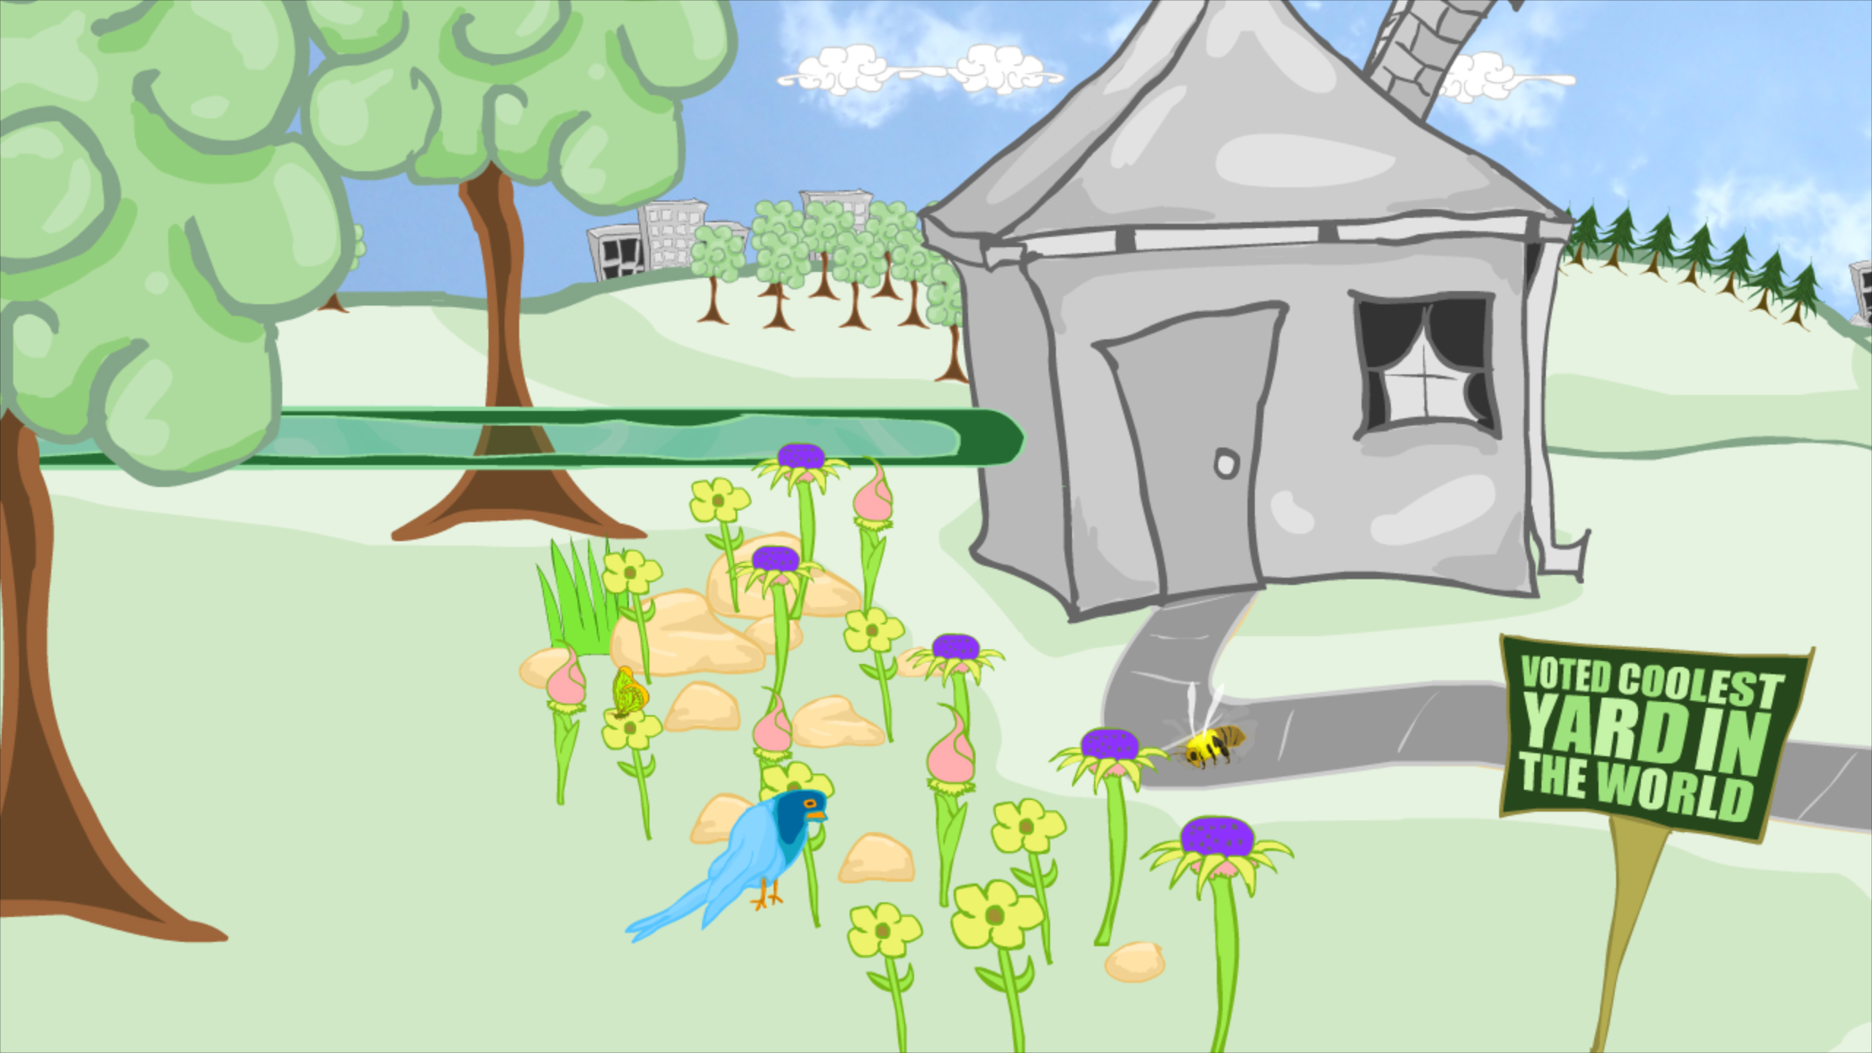
Thirsty lawns vs. Ocean Friendly Gardens

Slide 6
Rainwater Management Options

Slide 7
Current Situation: Water is pushed off land as if it was a nuisance

Slide 8
Current solutions…

Slide 9
Goal: Change & Integrate “fragmented” agency mandates & governance

Slide 10
Water Management should…

Slide 11
Solutions…

Slide 12
Conclusion: Know Your H2O
Unpredictable “droughts” & emergencies OR predictable prolonged dry weather patterns?
Water supply shortage OR water mismanagement?
Narrow focus on “new” water OR holistic & multi-benefit reform (including embedded energy reduction)?
Public Education of water/energy problems & solutions can drive reform!
Holistic reform offers govt. agency integration & cooperation/partnerships with NGOs!
ENVIRONMENTAL & ECONOMIC BENEFITS!!!

