Slide 1

What is the materials cost/benefit of solar technologies for the Desertec endeavor across North Africa?
Aurélien PLEE - Benoît GUILLEMBET

Slide 2
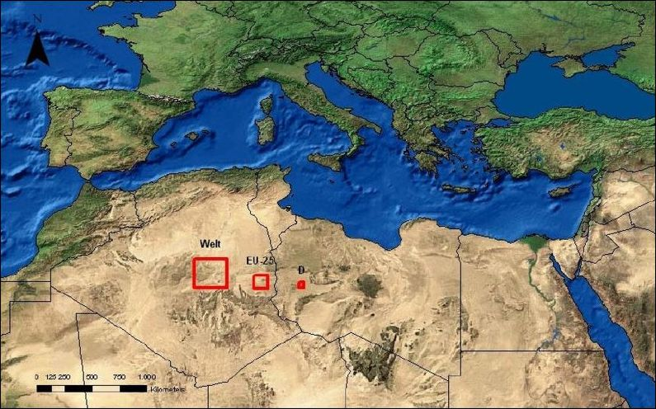
Introduction : DESERTEC project
Massive renewable energy plants in Northern Africa and the Middle East

Slide 3
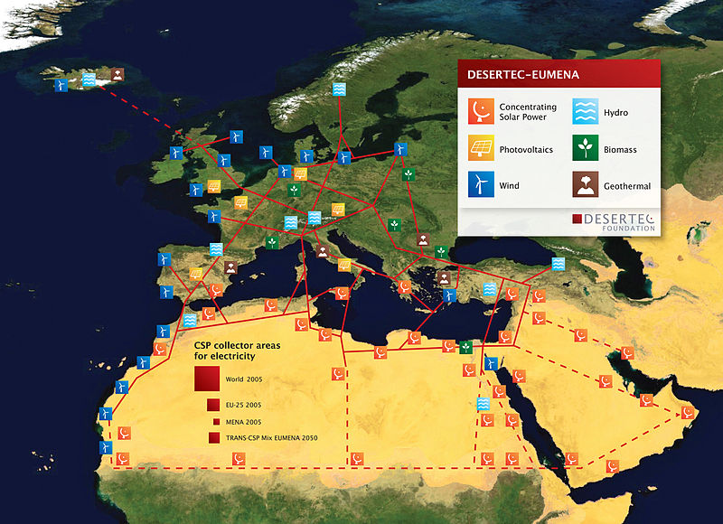
Introduction : DESERTEC project
700TWh by 2050 - around 15% of EU consumption
100 GW of solar power.
US$526bn, inc. $430bn for solar facilities

Slide 4
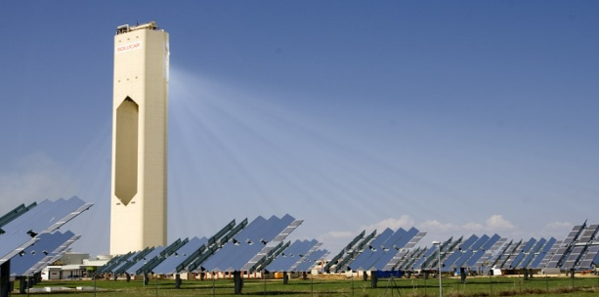
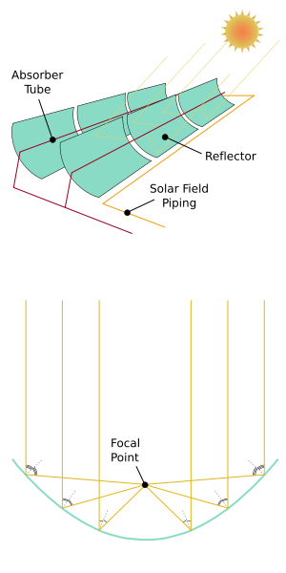
Solar technologies available
Technology | Current cost ($ cents/KWh) | Cost by 2020 ($ cents/KWh)
Solar power tower | 10 | 5.47
Parabolic through | 10 | 3.5 to 4.3

Slide 5
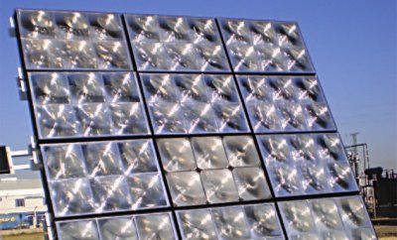
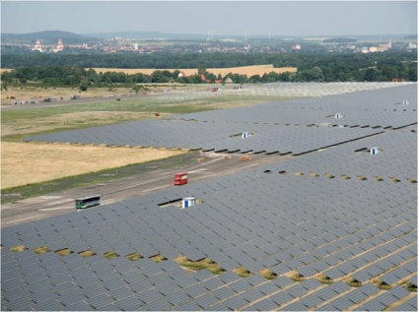
Solar technologies available
Technology | Current cost ($ cents/KWh) | Cost by 2020 ($ cents/KWh)
CPV | 18 to 28 | 12 to 17
PV systems | 4.2 | ??

Slide 6
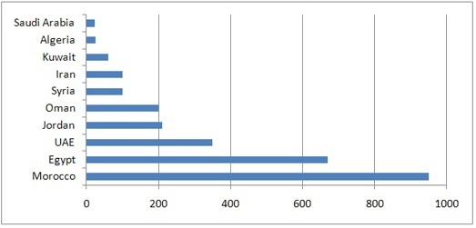
Satisfaction of DESERTEC needs
Morocco : 40% renewable in 2020 – 500MW CSP (Ouarzazate)
Algeria : 40% renewable in 2030 – 22GW by 2030 (12GW for domestic demand and 10GW for export) – 25MW parabolic through (Hassi’R’Mel)
Tunisia : 4.7 GW by 2030 – 2GW Tunur
Other countries of MENA (Middle East and North Africa) : 7.2 GW
Estimation : 470 GW by 2050 for MENA
Average planned capacities by 2017 (MW)

Slide 7
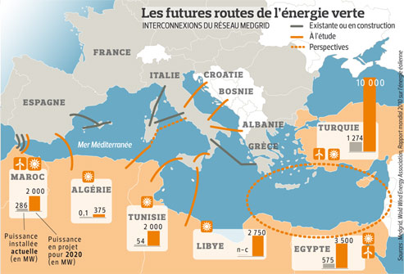
Satisfaction of DESERTEC needs
Set up a new electricity grid : MedGrid, based on HVDC (High Voltage Direct Current)
Future green energy grid

Slide 8
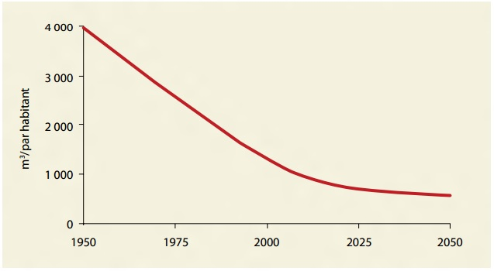
Water desalination
Arabian world : 5% of the world's population / 1% of fresh water.
18 of the 22 Arabian countries : water shortages / water distress by 2050
Water resources per habitant in MENA region

Slide 9
Water desalination through CSP
Principle : once the water is boiled in CSP, salt is separated from water; so you have drinking water
Competitive compared to fuel oil at $50/barrel (August, 30th 2012 : $95/barrel)
CSP desalination plants can supply up to several 100,000 m³/day (3,5 million ft³/day) of desalted water
→The huge solar energy potential of MENA can easily produce the energy necessary to provide the growing freshwater deficits in that region
Water resources per habitant in MENA region

Slide 10
Conclusion
DESERTEC : development of green energy for both MENA countries and EU
Enable the economic development of MENA countries, by selling energy produced to UE
Create jobs in MENA (ex: 20,000 jobs for 2GW Tunur plant in Tunisia)
Reduction of greenhouse gases, long term reduction of electricity cost, less dependance regarding fossil fuels
Enable to provide drinking water to Arabian countries
DESERTEC : a win-win deal
Thank you for listening

