Slide 1


Naturally Green Buildings
“Recreating our urban environment one building at a time”
WELCOME
World Resource Stimulation Center!
September 20, 2010
Jim Mumford, CLP, GRP
President
GoodEarthPlants.com
GreenRoofSanDiego.com
Notes:
Welcome and Thank you
Please turn your cell phones back on when you leave
To be clear, we are talking about a green roof, vegetated roof

Slide 2



Certified Landscape Professional (CLP)
Accredited Green Roof Professional (GRP)
California Licensed Landscape Contractor specializing in:
design, build, maintain
Certified Installer for:
RoofScapes Inc.,
LiveRoof
Elevated Landscape Technologies
Green Living Technologies
Notes:
11 green roofs to date

Slide 3
OPEN HOUSE!
Good Earth Headquarters
7922 Armour Street, San Diego, CA 92111
Friday, Sept 24 3:00 pm – 6:00 pm
Saturday, Sept 25 9:00 am – noon
Email Alexa@GoodEarthPlants.com and let us know which day you’ll be coming by!
Notes:
Only 45 minutes

Slide 4
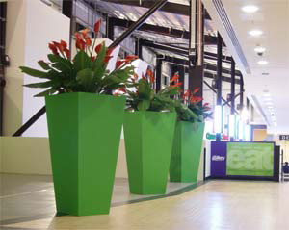
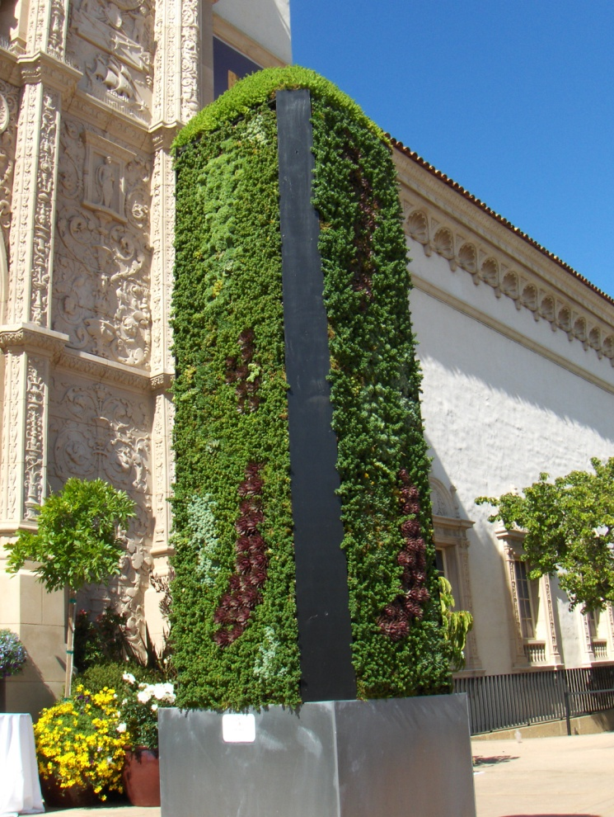
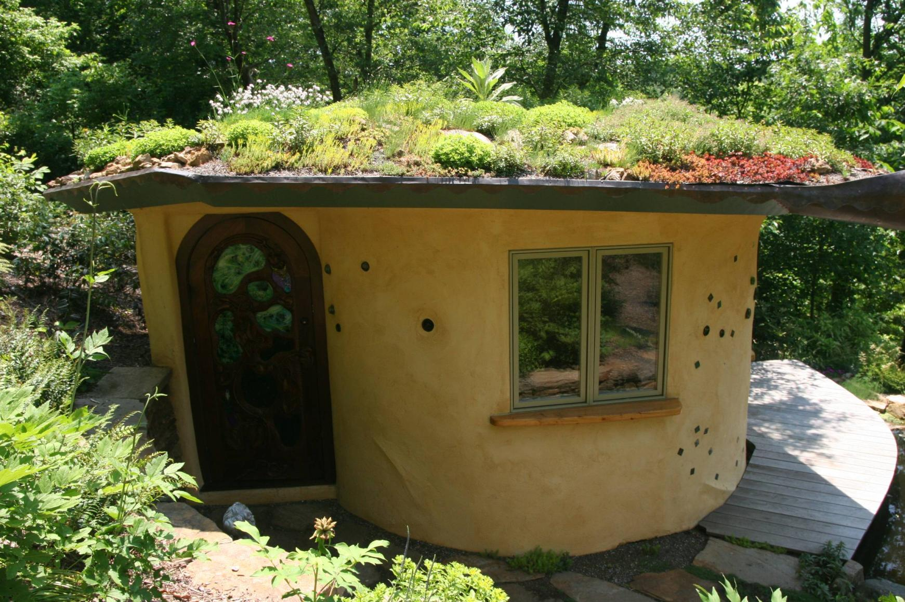
We grow plants in odd places!
Interiors
Roofs
Walls

Slide 5
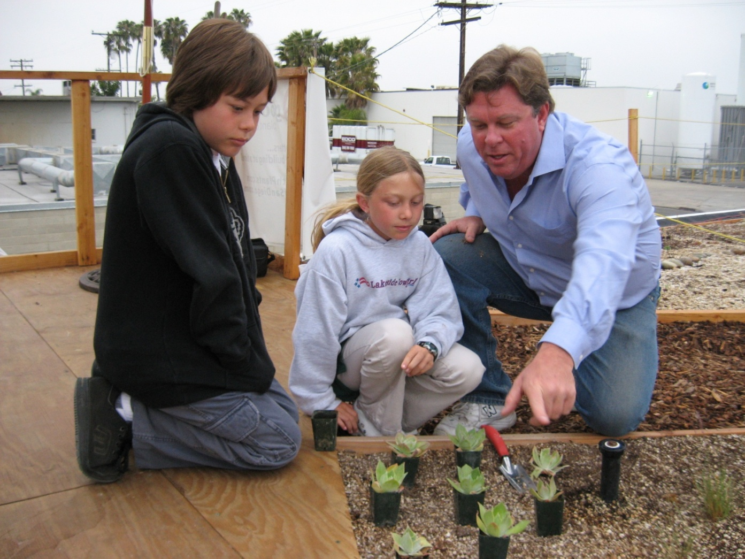
“We don’t inherit the earth from our ancestors,
we borrow it from our children.”

Slide 6
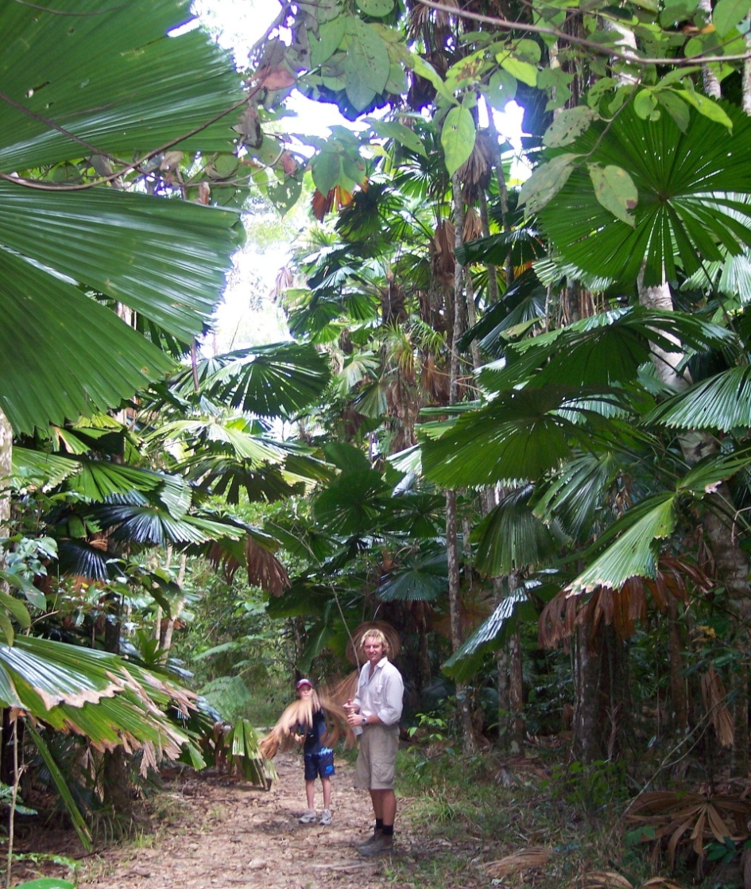
Ever since the Garden of Eden, we’ve needed plants for food, shelter, oxygen, our health and our well-being.

Slide 7
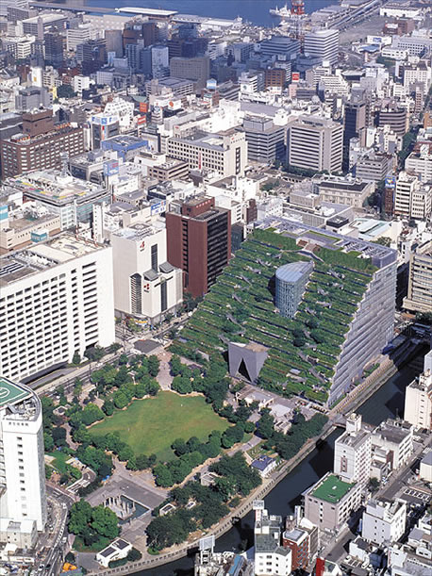
Notes:
Density is inevitable: over half of SANDAG ‘s population estimates are based on our kids sticking around
We cannot and should not continue to build outward – its unsustainable
Building up and in-fill projects are our future

Slide 8
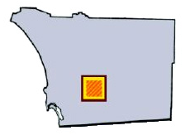
144 square miles of buildings, parking lots and roads - primarily impermeable surfaces….
….creates TOXIC RUN-OFF!
County of San Diego
Notes:
144 square miles of primarily impermeable surfaces creates toxic run-off
In nature, Most of what comes down from rain stays where it lands
In urban areas, most of it is run-off
Codes are changing

Slide 9
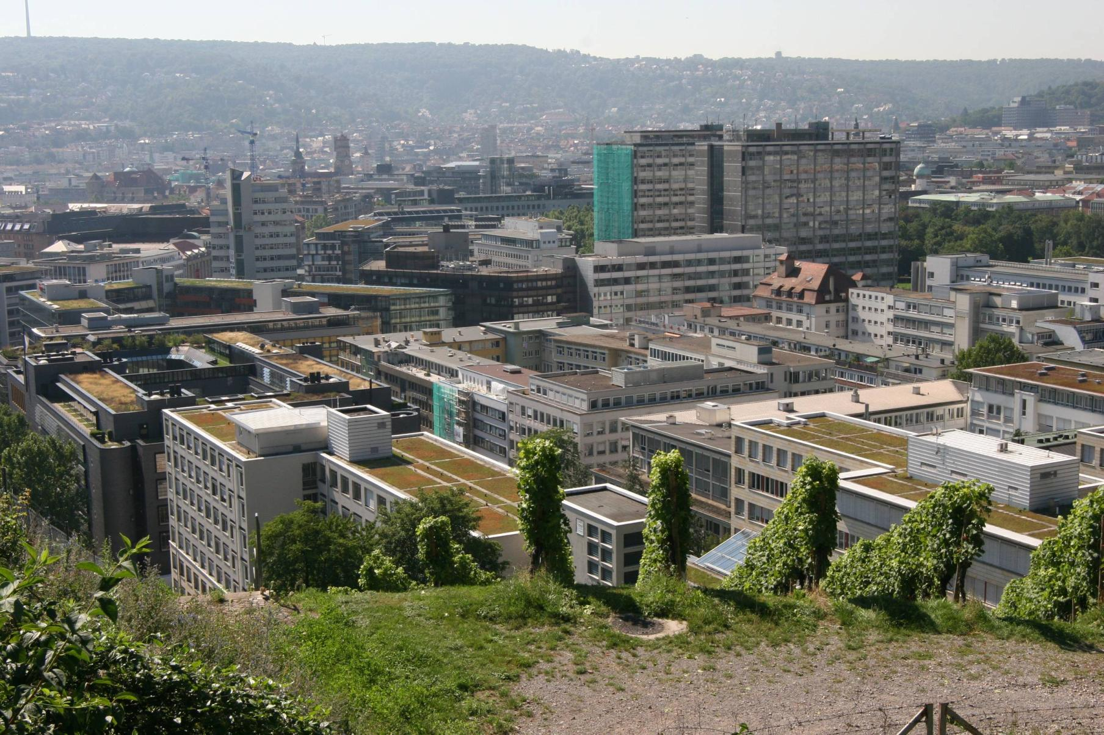
Notes:
Can you see all of the green roofs?
Environmental benefits:
cleaner air
oxygen production
carbon sequestration

Slide 10

What Scientific Research Shows
The US EPA
reports over 900
different VOC’s
may be present
in indoor air.
US EPA, 1989, Report to Congress on Indoor Air Quality, Volume II: Assessment and Control of Indoor Air: Effects of Individual Pollutants, Volatile Organic Compounds, p. 3-6.
Notes:
Volatile organic compounds

Slide 11
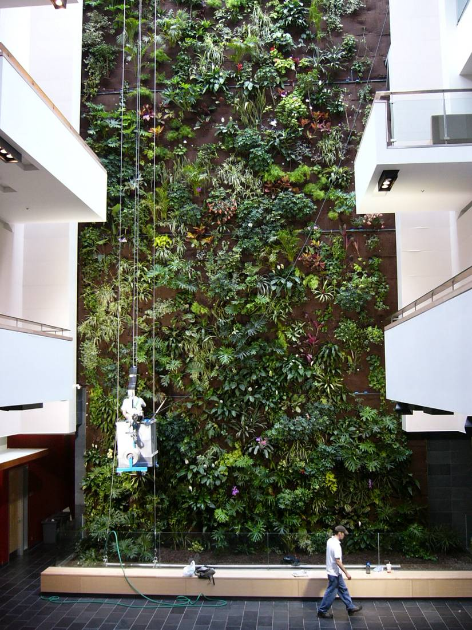
Air is drawn in through the green wall of plants.
Microbes break down the VOC’s into compounds that
plants use for growth.

Slide 12
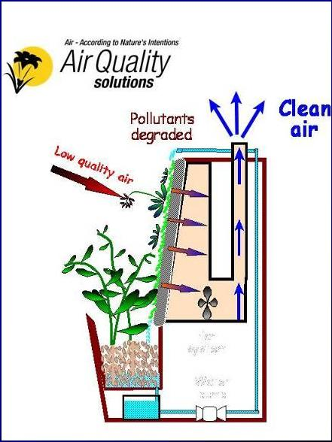

Slide 13
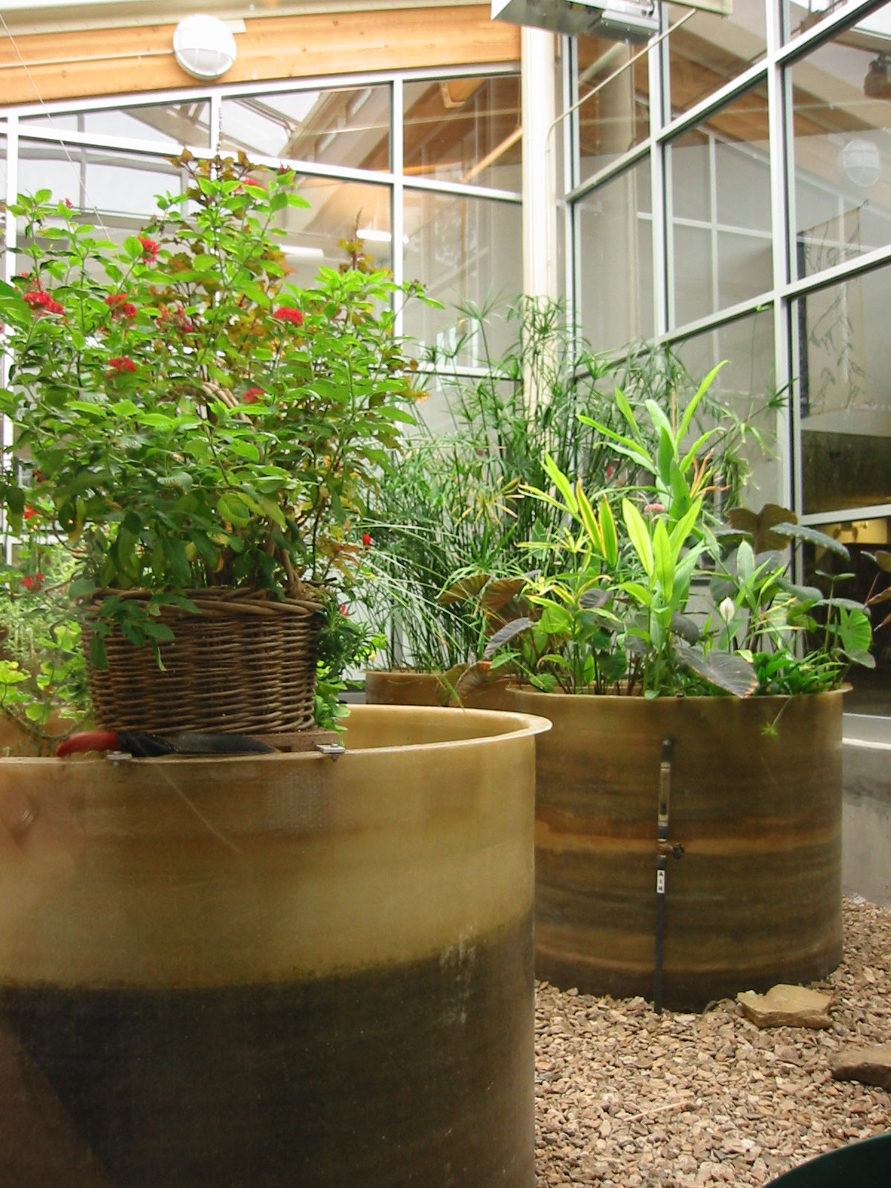
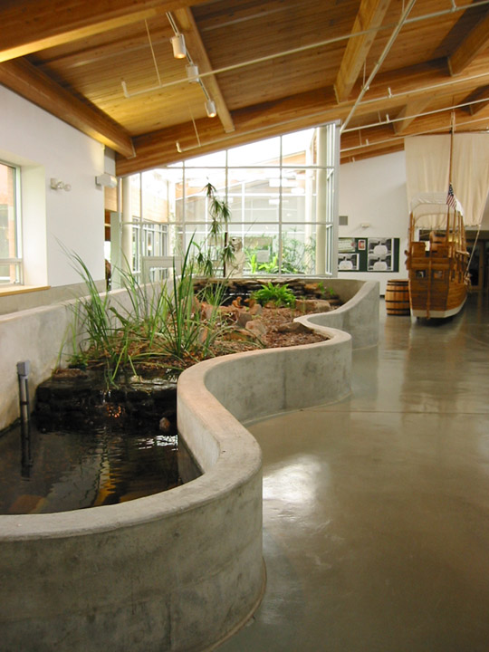

Slide 14
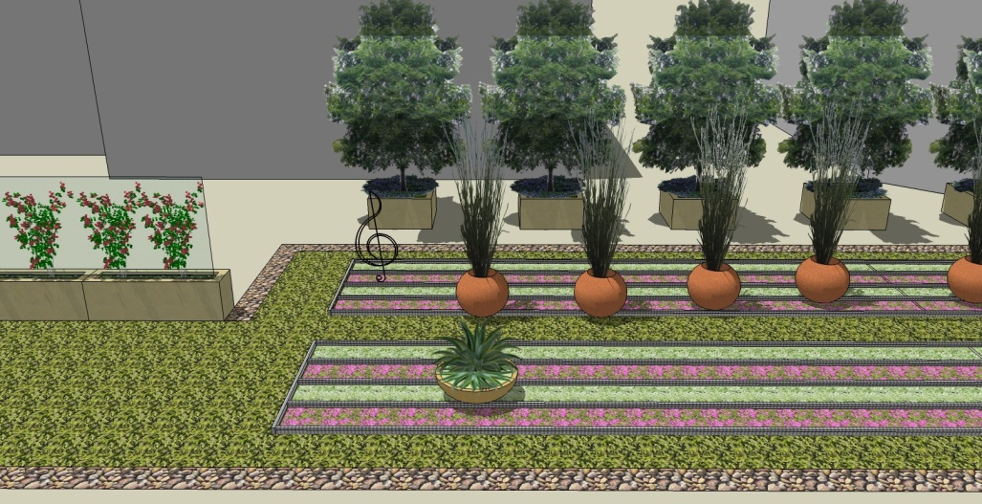
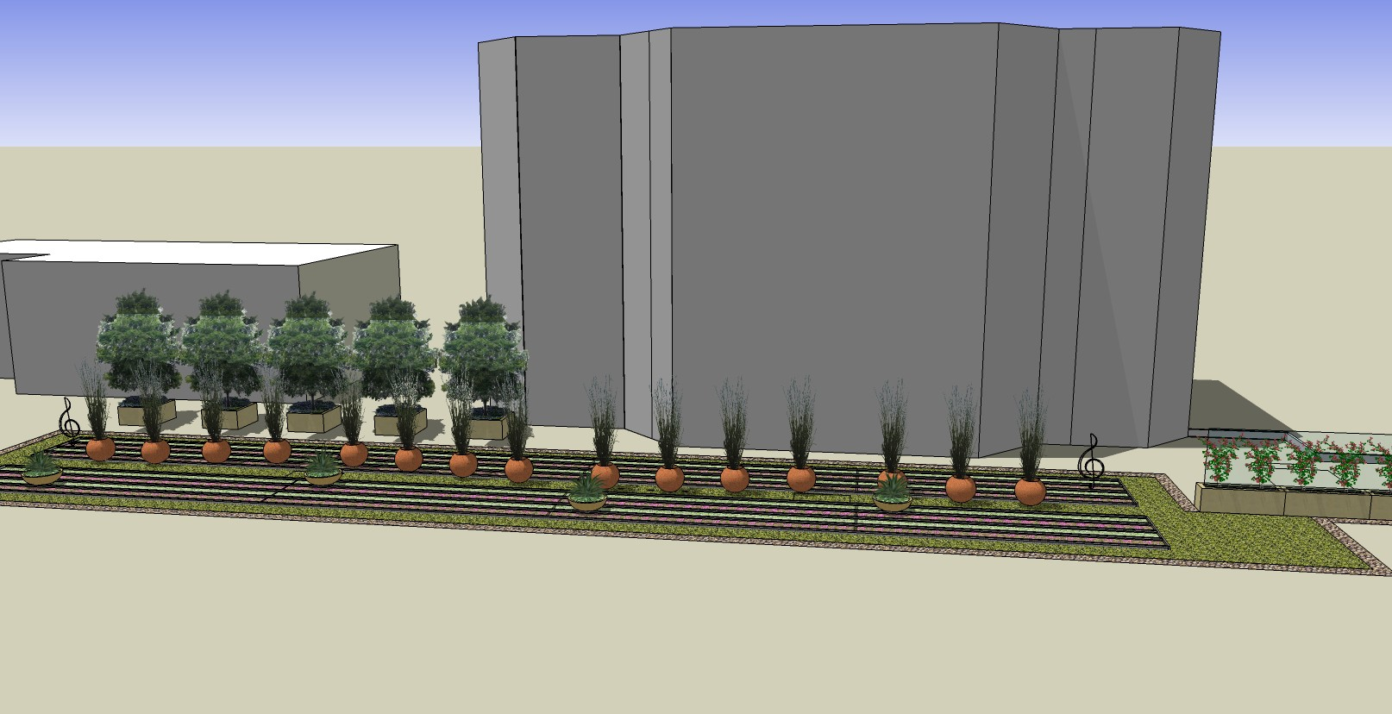
Research shows that a view of plants may help hospital patients recuperate faster, with less pain and anxiety.
Landscape design by: Schmidt Design Group

Slide 15
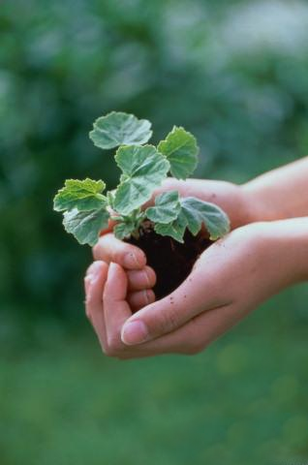
2/3 of Americans cite gardening as their favorite hobby.
Source: Gallop Poll
Notes:
Profitable, because it is in our nature to be drawn to all things green.
The average American spends a third of their lives in the office. At home, two-thirds of Americans site gardening as their favorite hobby.
When asked specifically if the physical workplace would have an influence on their decision to accept a position, two out of five employees said it would. Half said the physical workplace would impact their decision to leave a position.
Plants are a important part of peoples lives …they should also be included in their workplace.

Slide 16
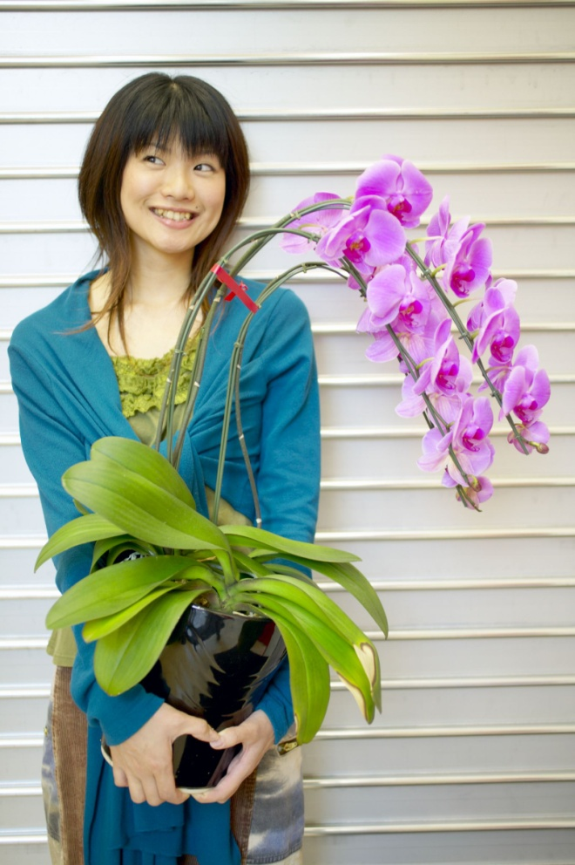
People have more positive emotions when exposed to plant settings.
Source: Health Benefits of Gardens in Hospitals, Roger S. Ulrich, Ph.D., 2001
Notes:
We now know the realities of workplace stress…
(2.) Once exposed to plant settings, test persons demonstrated more positive emotions such as happiness, friendliness and assertiveness and less negative emotions such as sadness, anger and fear[1]
[1] Health Benefits of Gardens in Hospitals, Roger S. Ulrich, Ph.D., 2001 Center for Health Systems and Design
Colleges of Architecture and Medicine, Texas A & M University, College State, TX 77843

Slide 17
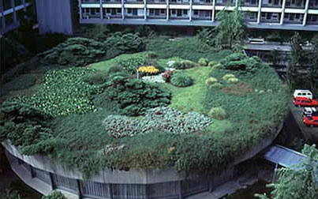
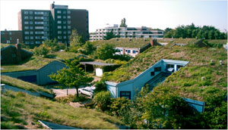
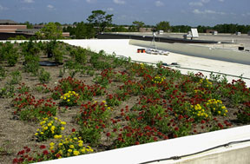
What is a Green Roof?
Also known as:
  Living roof
  Vegetated roof
  Eco roof
  Brown roof
  (spontaneously seeded)
Notes:
Living roof
Vegetated roof
Eco roof
Brown roof (spontaneously seeded)

Slide 18
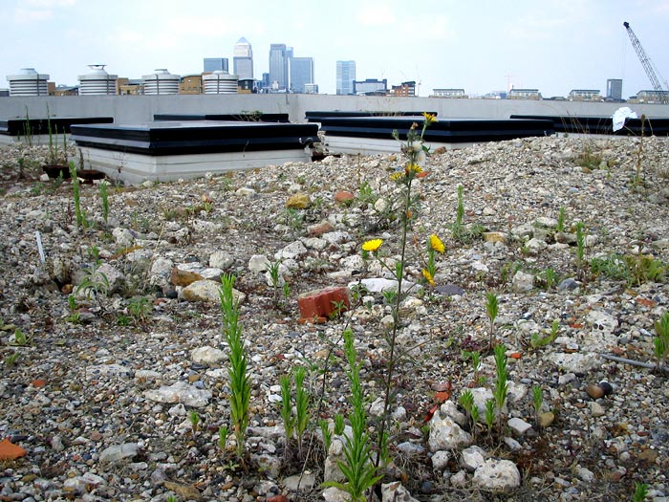

Slide 19
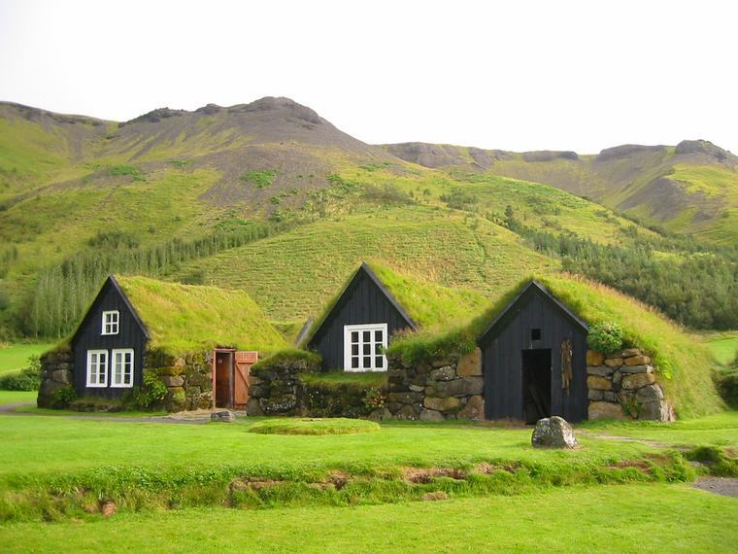
Definition
  An engineered, lightweight roofing system that supports plants (NOT PLANTER BOXES)
  On top of a man made structure
  Below, at or above grade
  Up to 40% slope
  Every one is different!
Notes:
An engineered lightweight system that supports plants
on top of man made structure
at, below or above grade
40%
Every one is different

Slide 20
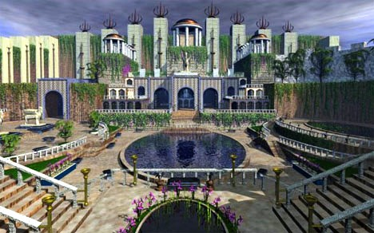
Hanging Gardens of Babylon
Notes:
4. Green roofs
History / where
Sod roof
Egyptians, Romans, Vikings
German, Japan and northern Europe for the past 30 years
Portland first in US
Chicago city hall in 2000, now 250 green roofs
New York, Toronto, Vancouver, Boston
When
Now!
Designed from the beginning
Retrofit with a new roof

Slide 21
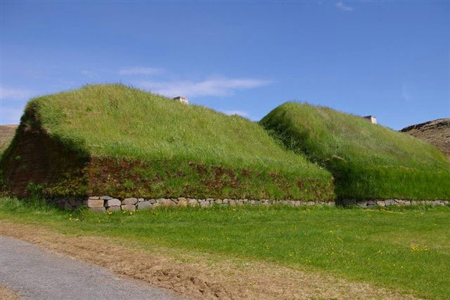
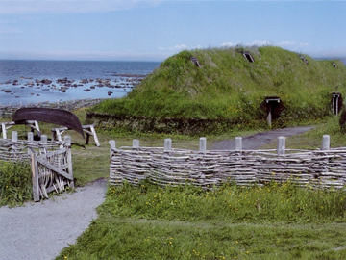
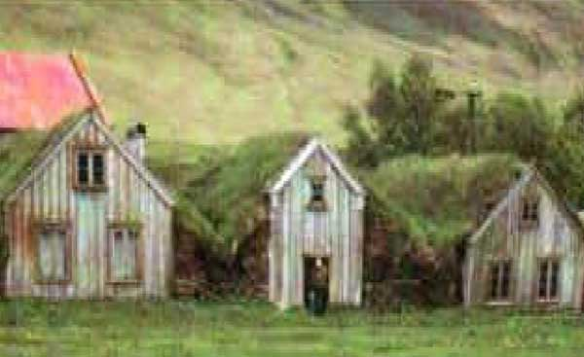
Egyptians, Romans, and Vikings

Slide 22
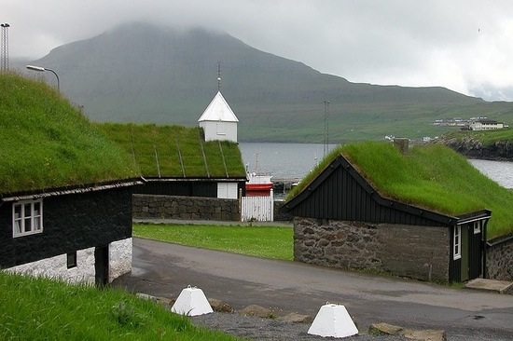
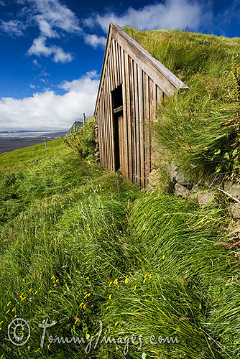
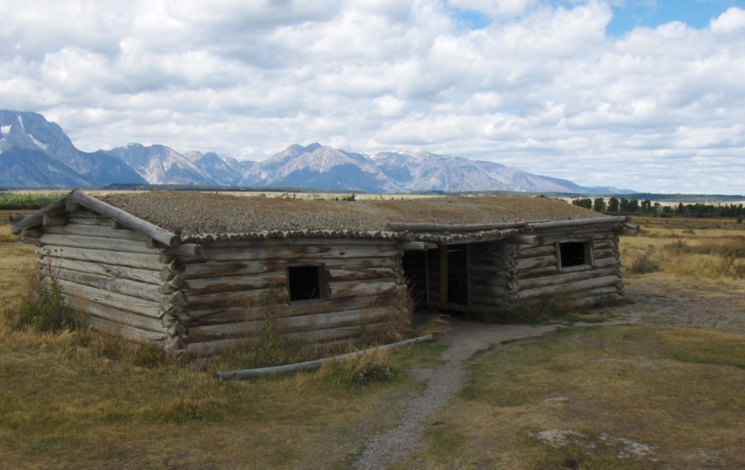

Slide 23
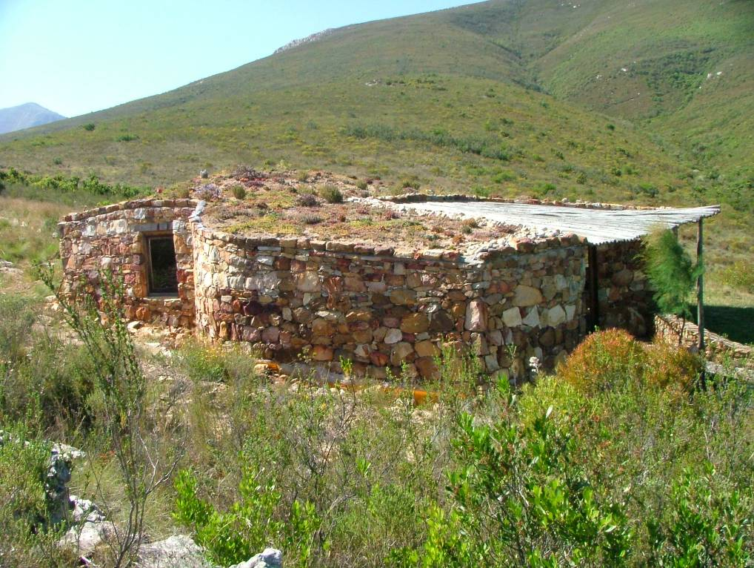
Notes:
23
South Africa

Slide 24
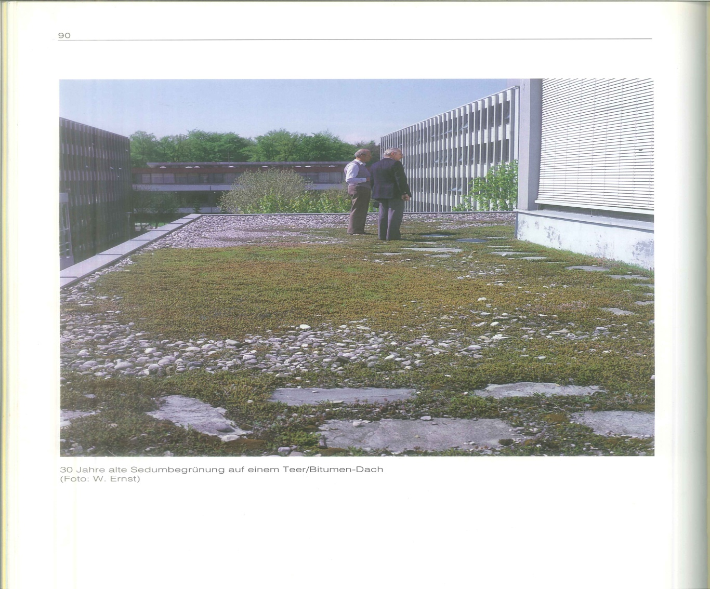
Germany 1962
Notes:
Setting the industry standards
17% of all low sloped buildings are green roofs
Carrot vs. stick

Slide 25
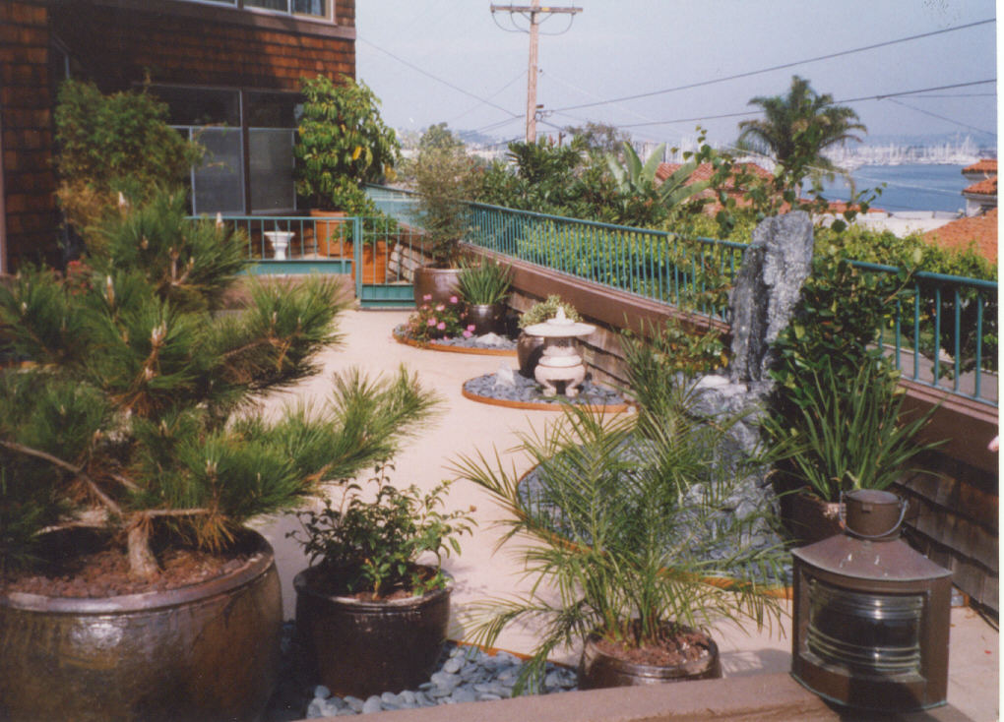
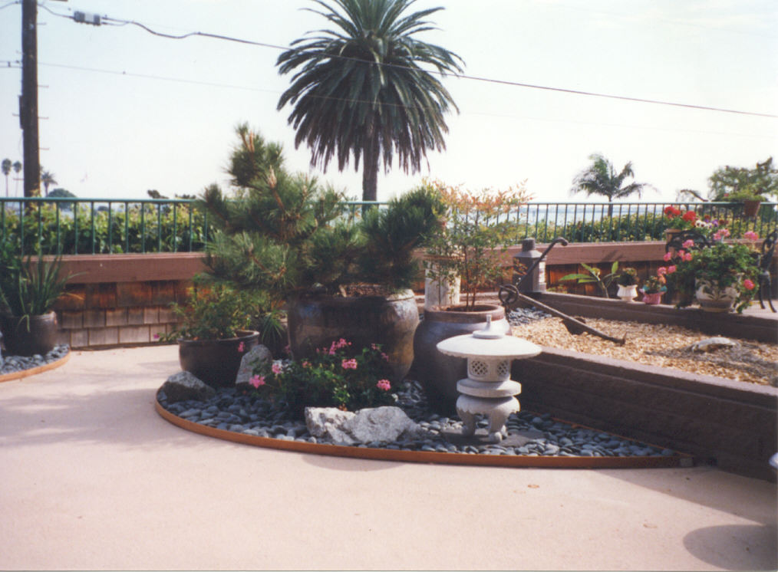
Notes:
1, Introduction
a. Thank You
b. Why I am here
GEP history with container plants
My interest in green roofs

Slide 26
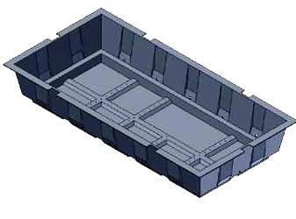
Notes:
AIA modular tray

Slide 27
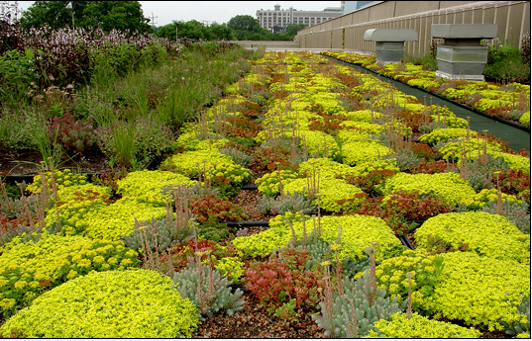
Notes:
Client comfort
Pre-planted
Easy to get on the roof
temporary

Slide 28
Benefits of Green Roofs
Owner
Longer Roof Life
Reduces HVAC
Increases Property Value
LEED Points
Community
Storm water
Urban Heat
Island Effect
Improves Air
Quality
Biodiversity
Visual Appeal
Reduces
Landfill Waste
Tenant
Found Space
Lower Energy Costs
Fire Retardation
Noise Abatement

Slide 29
Notes:
photovoltaic

Slide 30
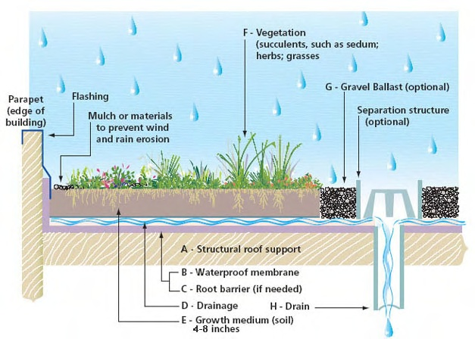
Notes:
Built up systems
Layering
insulation
drainage
Root barriers

Slide 31
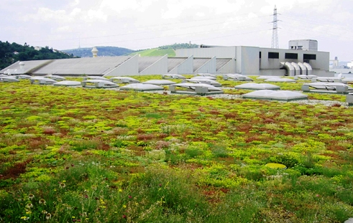
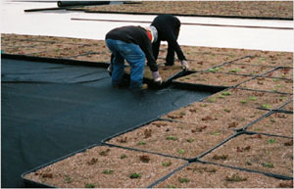
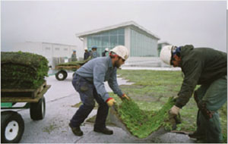
Green roof types
Extensive
  Think “sod” roof
  Less than 6” of growth media
  Less plant variety
  Less expensive (as low as $9/sq ft)
  Light weight (approx. 7lbs per inch /sq ft)
  Limited access
  Could be modular
  Low maintenance
Notes:
Learned:
Extensive
Think “sod” roof
Less than 6” of growth media
Less plant variety
Less expensive ($12-15/sq ft)
Light weight (approx 12 lbs/sq ft)
Limited access
Could be modular
Low maintenance
Get a goat!

Slide 32
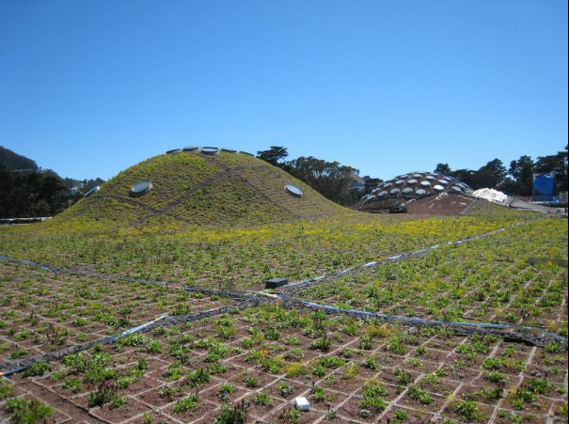

Slide 33
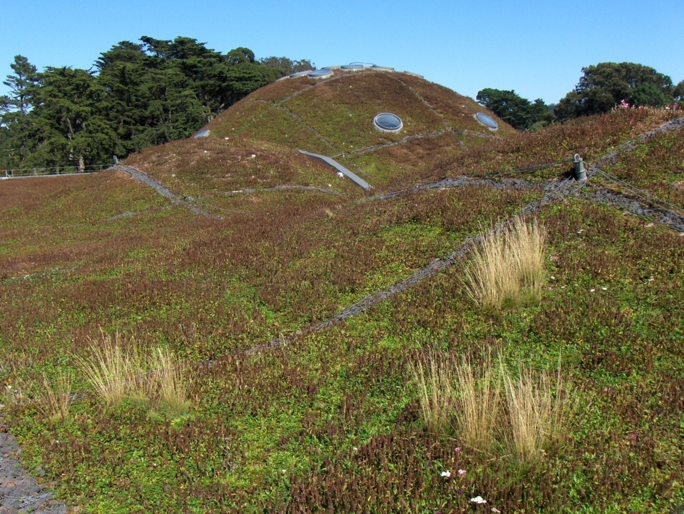

Slide 34
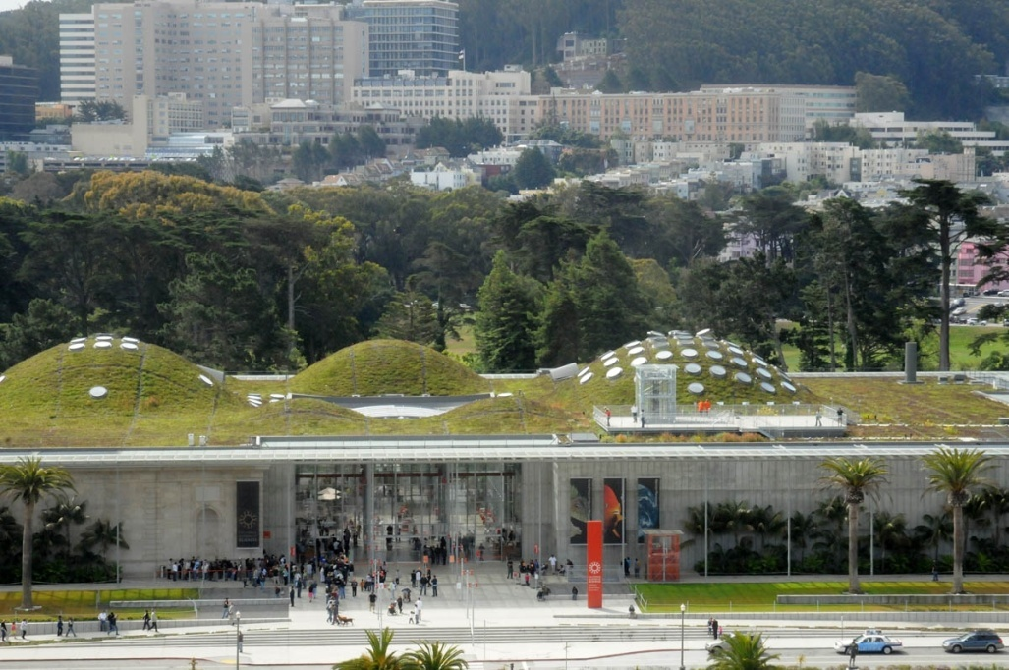
Notes:
Observation deck

Slide 35
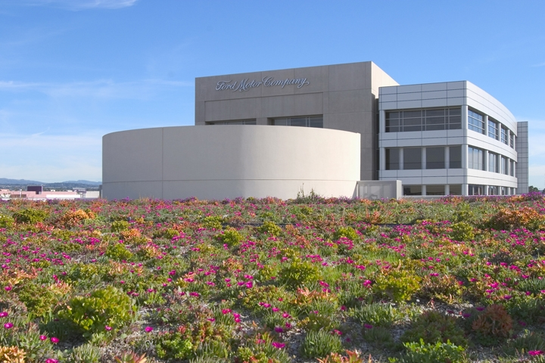
Notes:
colorful

Slide 36
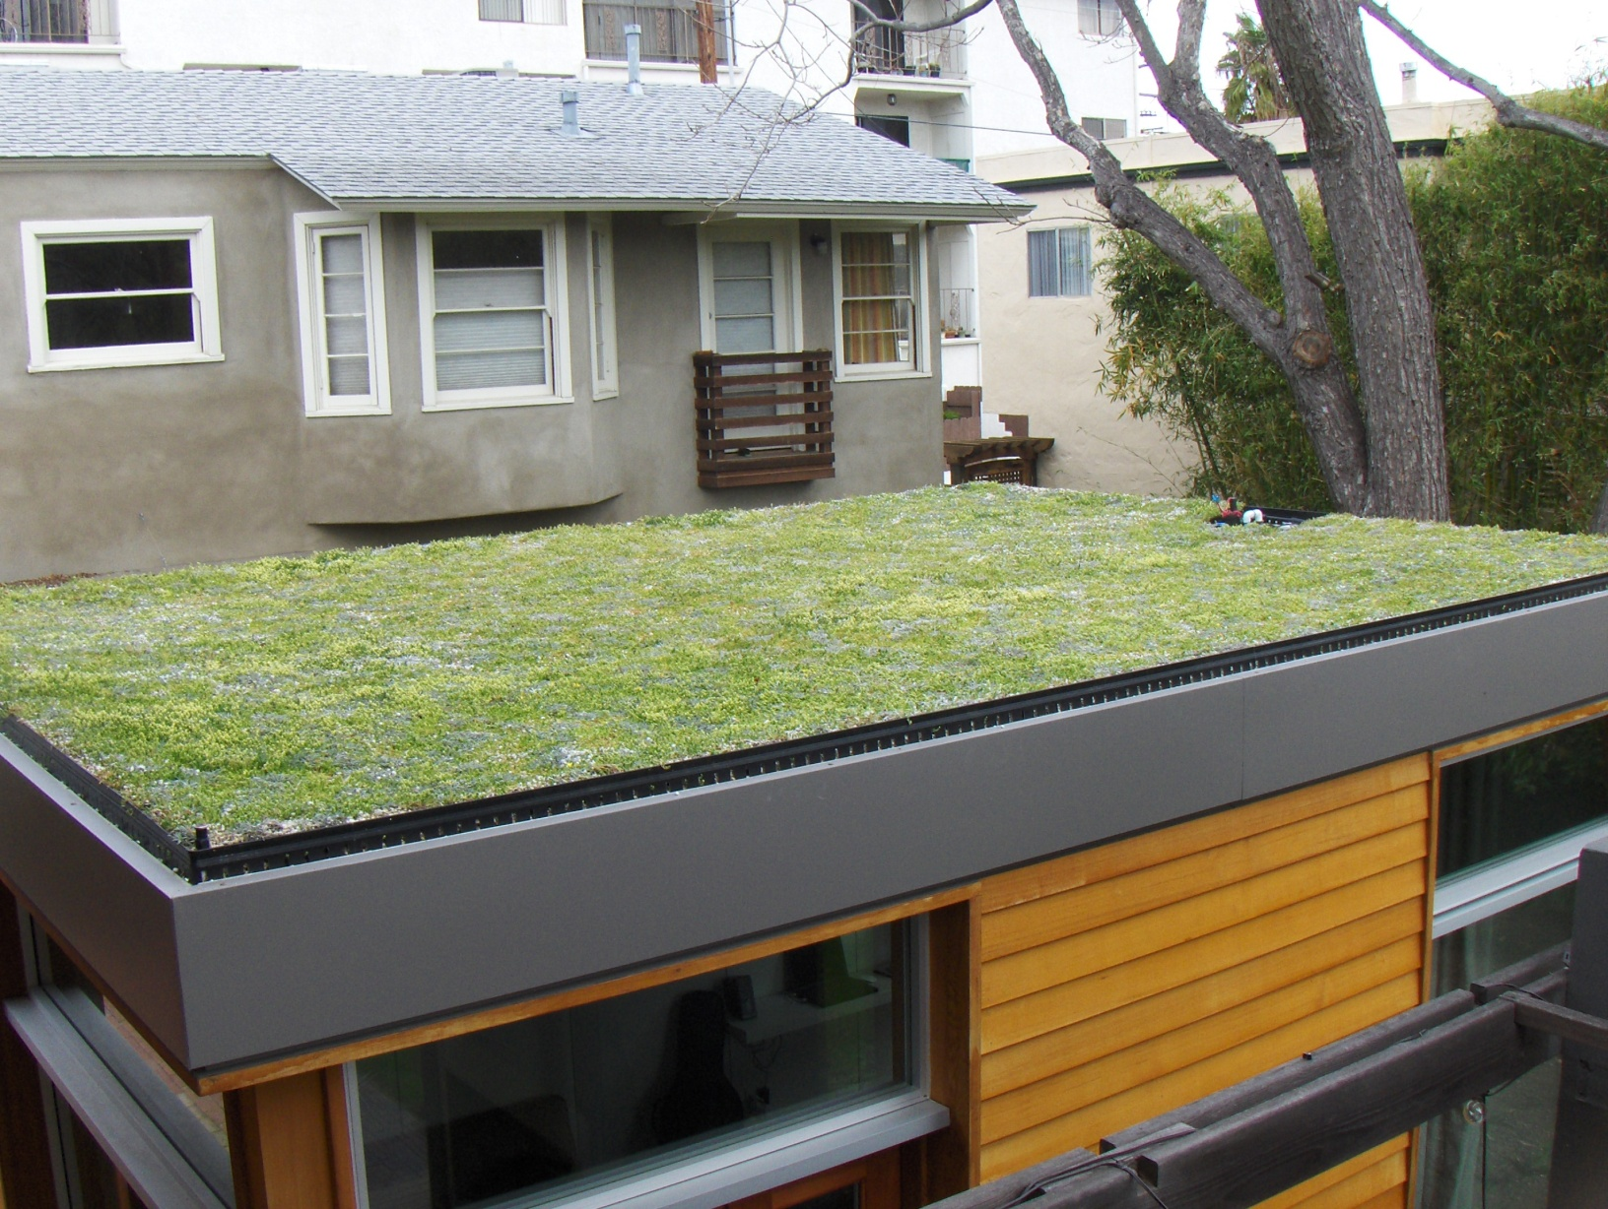

Slide 37
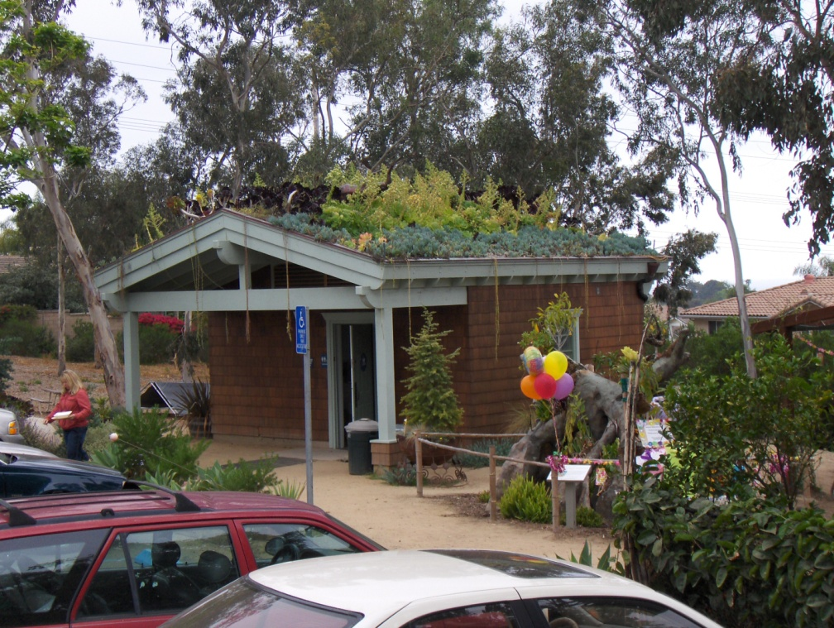
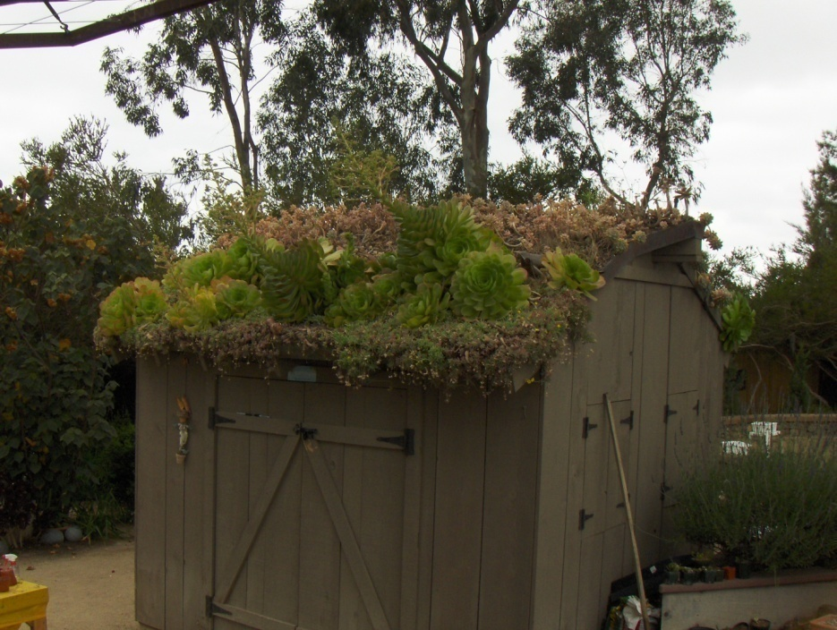

Slide 38
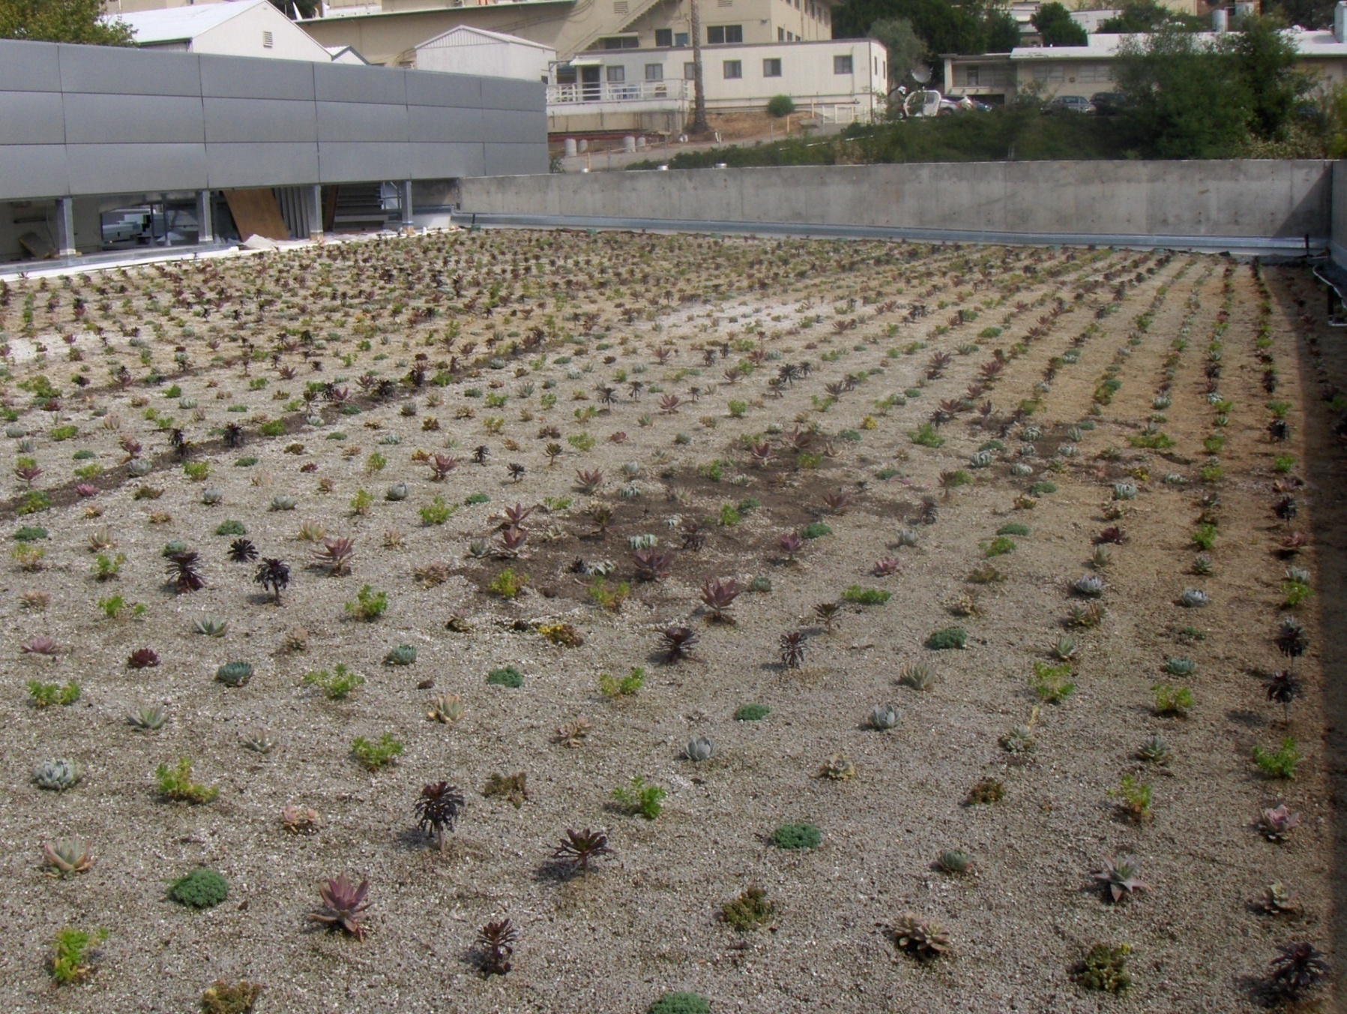

Slide 39
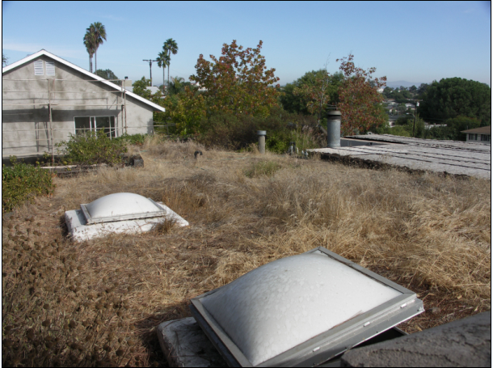
Notes:
Leaked
Low priority
Weed experiment

Slide 40
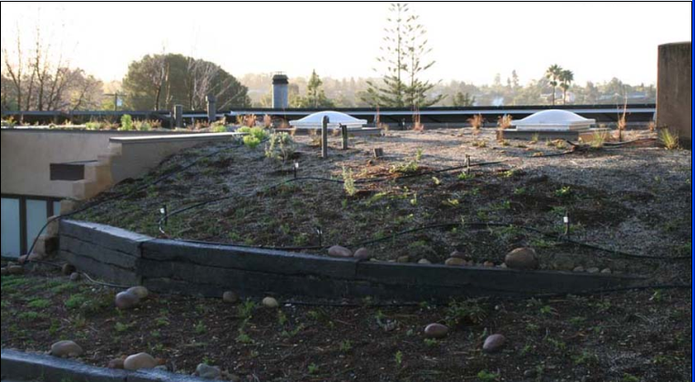

Slide 41
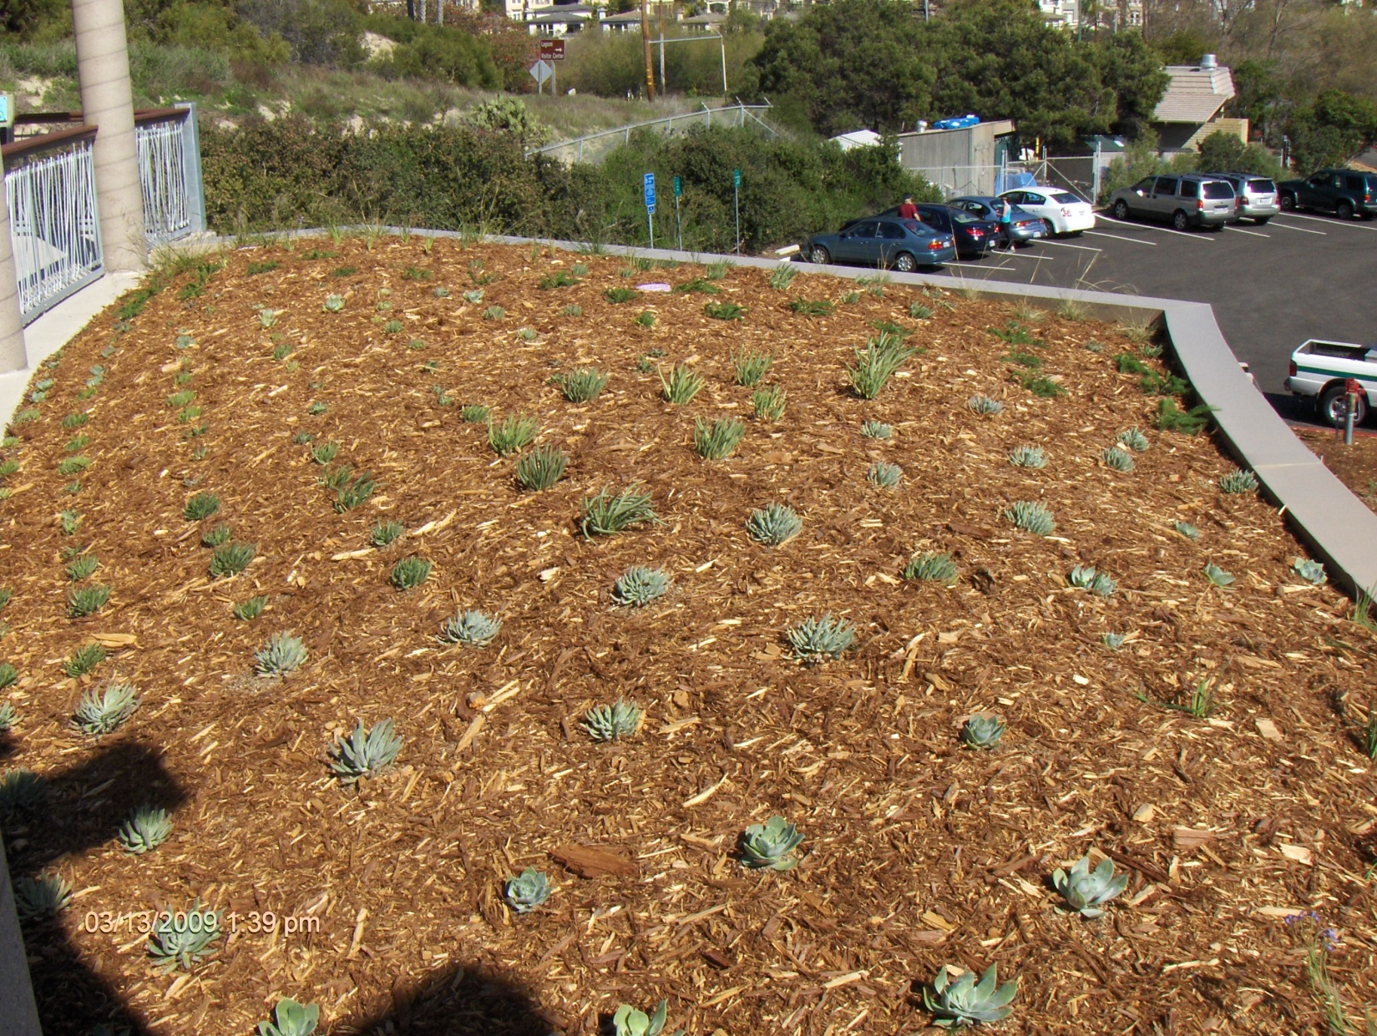

Slide 42
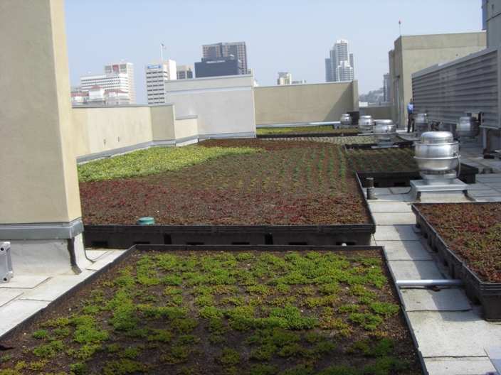

Slide 43


Slide 44


Slide 45


Types of Green Roofs
Intensive
  Think “roof top garden”
  6” or more growth media
  Virtually any variety of plant
  Higher cost
  Higher weight
  Higher maintenance
  Full access
Notes:
Intensive
Think “roof top garden”
6” or more growing media
Virtually any variety of plant
Higher cost
Higher weight
Higher maintenance
Full access

Slide 46



Slide 47


Slide 48

Notes:
City Front Terrace

Slide 49

Notes:
SDSU

Slide 50



Slide 51


Slide 52


Slide 53


NO TWO ARE ALIKE….
Notes:
Learned:
no two are alike

Slide 54

Team Approach
Client
Green Roof Consultant
Engineer
Architect
Roofer
Horticulturist
Landscape Architect

Slide 55

Three Primary Goals of
Green Roofs
1. Maintaining structural integrity
  Load bearing
2. Ensuring that the waterproofing is intact and functioning
3. Ensuring long-term health of plant life
  Sustainable

Slide 56
At we
design, build and maintain everything
above the waterproof membrane.
And focus on:
Drainage
Media
Irrigation
Plants
Maintenance

Slide 57


Project Objectives
Aesthetic
Storm Water Management
Energy Savings
LEED Certification
Biodiversity
Amenity Space
Noise reduction
Urban Agriculture
Education

Slide 58

Budget
Installation &
Maintenance

Slide 59




Drainage Layer
Notes:
f. Drainage Layer
Carlisle Miridrain GR 9200
Allows excess water to flow freely to the drains
Feet cups retain water

Slide 60




Irrigation
Notes:
Good for natives

Slide 61


WATER!
Notes:
Water

Slide 62

Notes:
The result of no water
Low bid contractor in 2007
Turn off the water
We are working with the owners to restore this roof
My office reminds me not to get too negative by addressing too many issues and problems, and the barriers that need overcoming
At times I want to throw some dirt on the roof a few plants and call it a day
Stan Keniston, architect
is very concerned that these are done right, safely

Slide 63

ALTERNATIVE SOURCES OF WATER:
Rain water
Purple pipe
Air conditioner
condensate
Gray water
Notes:
By and large, the myriad of benefits of a green roof will out-weigh the marginal use of potable water

Slide 64







harvesting
Rainwater

Slide 65


Slide 66





Slide 67



Slide 68

Safety
Notes:
Personal fall protection device
Lanyard and a clip on

Slide 69

Vegetation
Climate
  Sun
  Wind
  Temperature
  Rainfall
  Micro-climate
  Hot and windy
  Shade
Notes:
sexy

Slide 70

sedums

Slide 71

Notes:
Zero water use

Slide 72

Notes:
Alpine meadow

Slide 73




Notes:
natives

Slide 74


Planting Methods
Seeds
Hydro Seed
Cuttings
Plugs
Vegetated Mats
Pre-Grown Modular
Notes:
Climate and season sensitive

Slide 75

Maintenance
(Required with Warranty)
Establishment Period
Water Availability
Weeding
Fertilization
Drainage
Documentation
Notes:
10 year single source warranty for plants and leaks
2 years
80% coverage

Slide 76

Notes:
Wind scouring

Slide 77

Notes:
Hand applying weed killer

Slide 78

Notes:
Mowing sedums

Slide 79


Slide 80



ELECTRIC FIELD VECTOR MAPPING
Notes:
Apparent:
team

Slide 81




Slide 82


Slide 83






Patrick Blanc, France

Slide 84





Slide 85


Notes:
We get asked a lot to do vegetables on roofs
Labor intensive
Occupancy issues tied to load bearing and safety
Vertical farming

Slide 86


Maintenance
Fertilization
Check and adjust irrigation
Pest management
Edibles - crop rotation

Slide 87

Green Roof Project

Slide 88


Slide 89






Green Roof Project
Underlayment
Waterproofing
Flood Test
Protection Layer
Drainage Layer
Perimeter Framing
Notes:
c. Underlayment First Layer - Foil Faced 1/2” Polystyrene Foam Board
Insulation
Improves puncture resistance

Slide 90

Project Completion – March 2007

Slide 91

March 2008

Slide 92

August 2009

Slide 93

September 2010

Slide 94

Notes:
Imagine while small, all roofs were greened

Slide 95
Barriers
Cost
Load Bearing
Water Source
Building Code/Permits
Incentives, Subsidies and Rebates

Slide 96



Policy Change
Senator Maria Cantwell
Washington
Clean Energy Stimulus and Investment Assurance Act (S.320)
30% tax credit
50% minimum coverage
$5,000 residential cap
New or retrofit
Notes:
Senator Maria Cantwell of Washington State

Slide 97


Slide 98

In the future, green roofs will be a key element of every construction program, an art and science born of necessity. However, we will look back and wonder why common sense did not lead us down this path sooner. The energy, stormwater, climate and health benefits are indisputable.
Vicki Estrada
Notes:
In the future, green roofs will be a key element of every construction program, an art and science born of necessity. However, we will look back and wonder why common sense did not lead us down this path sooner. The energy, stormwater, climate and health benefits are indisputable.
Vicki Estrada

Slide 99

“The future belongs to those that give the next generation reason to hope.”
- Teihard de Chardin
THANK YOU!
Notes:
Green roofs, green walls,
living buildings,
restorative buildings
Low impact design LID

Slide 100
OPEN HOUSE!
Good Earth Headquarters
7922 Armour Street, San Diego, CA 92111
Friday, Sept 24 3:00 pm – 6:00 pm
Saturday, Sept 25 9:00 am – noon
Email Alexa@GoodEarthPlants.com and let us know which day you’ll be coming by!
Notes:
Only 45 minutes

