Slide 1
Feed-In Tariffs
Scaling Cost-Effective Renewables
in a Timely Fashion while Delivering Unparalleled Economic Benefits
Craig Lewis
Executive Director
FIT Coalition
650-204-9768 office
craig@fitcoalition.com
www.fitcoalition.com
10 September 2010

Slide 2
Mission
To implement global best-practices for scaling cost-effective renewable energy in a timely and environmentally sustainable fashion
FIT Coalition Overview
Board of Advisors
Jeff Anderson
ED, Clean Economy Network
Josh Becker
General Partner, New Cycle Capital
Jeff Brothers
CEO, Sol Orchard
John Geesman
Former Commissioner of the California Energy Commission
Patricia Glaza
ED, Clean Technology & Sustainable Industries
Dan Kammen
Distinguished Professor of Energy, UC Berkeley, Energy and Resources Group
L. Hunter Lovins
President, Natural Capitalism Solutions
Terry Tamminen
Former Secretary of the CA EPA and Special Advisory to CA Governor Arnold Schwarzenegger
Jim Weldon
CEO, Solar Junction
R. James Woolsey
Venture Partner, VantagePoint, Former Director, CIA
2

Slide 3
Leading the World into the Future
Solar,
Wind,
Electric Vehicles
Energy Efficiency
Nuclear,
Biofuels,
Other
Fossil
Fuels
Solar
Wind
Storage
Demand
Response
Electric
Vehicles
Nuclear
Biofuels
Other
Fossil Fuels
Economic sensibility
National security
Environmental sustainability
The $6 trillion energy market will transition to Smart Energy
3

Slide 4
FITs Make the Solar Industry
Source: Navigant Consulting
86% of the world’s solar PV deployments in 2009 were driven by FITs,
and the percentage is increasing
4

Slide 5
FIT Features & Benefits
FIT Features
  Standard must-take contract for renewable energy
  Cost-based, technology-differentiated rates that are fixed for 20 years
    Fixed rates are set to attract deployments
    Degression reduces rates paid for new contracts based on cost reductions driven by economies-of-scale and learning
  Guaranteed interconnection for any project designed within the guidelines of the FIT program
  Renewable energy is purchased at wholesale with environmental attributes
    All environmental attributes, including RECs, are bundled with the energy sale
FIT Benefits
  Simple, fair, and effective
  Solves all critical issues for deploying renewables: financing, procurement, and interconnection
  Most effective policy in the world for getting cost-effective renewables online in a timely fashion
  Avoids any type of solicitation process, including auctions, and the overwhelming parasitic costs and parasitic time associated with solicitations
5

Slide 6
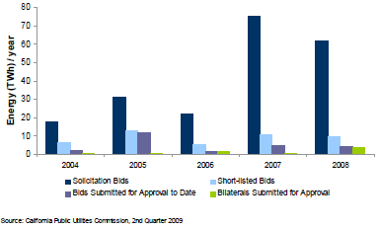
Auctions Have Huge Failure Rates
California RPS Project Failure Rate is ~97%
FITs eliminate the massive parasitic costs associated with solicitations
6

Slide 7
FITs = Unparalled Market Mechanism
Volume
Standard Must-take Contract (SMC)
S2 (FIT)
Reduced developer risk
Same price drives significantly more volume
S1 (solicitation)
D2 (FIT)
D1 (solicitation)
Supply and demand with solicitation process
Price
Supply and demand with a FIT program

Slide 8
Scaling the RPS Challenge
Sources: CPUC, CEC and UC Berkeley; Sep09.
California needs the equivalent of 40GW of solar between today and 2020
8
Notes:
Not on pace: Since the inception of the RPS program in 2002, California has actually REDUCED its percentage of energy coming from renewables: over 14% in 2002, 13% in 2008. 75% from wind, biomass and geothermal.

Slide 9
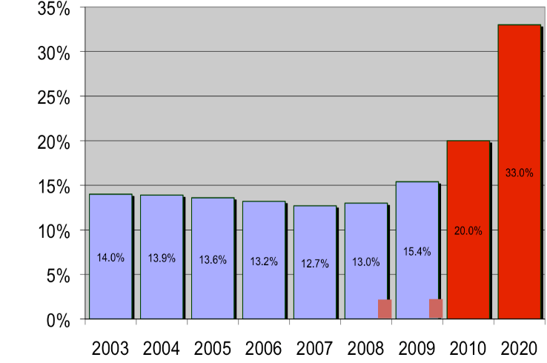
California’s RPS Reality
Only 357 MW total renewables
added in 2009, same as 2008
~40 GW
required
352 MW total renewables
added in 2008
>10 GW
required
Sources: CPUC, CEC and UC Berkeley; Jul10.
2009 explained: California still needs 10x improvement to ~4 GW/year

Slide 10
Deployments Drive Everything
Developers
Technology
Systems
Generation Projects
Utilities
Investors
Debt
Equity
The entire renewable energy value chain depends on deployments

Slide 11
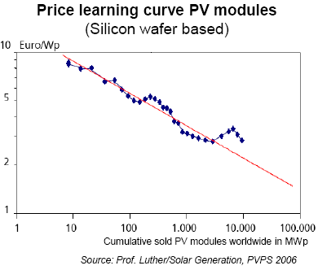
Volume Drives Learning
Solar pricing is reduced by 20% for every doubling of deployed volume
Si learning curve
New technology learning curve
Efficiency innovation

Slide 12
FITs Drive Solar
Solar Markets: Germany vs California (RPS + CSI + other)
Cumulative MWs
Sources: CPUC, CEC, SEIA and German equivalents.
Germany added17 times more solar than California last year!
Even though California’s solar resource is about 70% better!!!
12
Notes:
Prior to 2000 a small fraction of 1 GW of PV generation attached to the grid. By 2007, 4 GW were attached, representing 53% of the world’s PV generation One point one (1.1) MWs of PV generation were added to the system in 2007 . Cost-benefit analysis by German government documented an almost 1 to 3 costs-to-benefits advantage. Displacement of conventional energy by FIT energy reduced the wholesale price of electricity in an aggregate amount greater than the incremental cost of the FIT price. Rickerson, CEC Feed-In Tariff Workshop, 6/30/08, Slide 19.
In 2007 Germany had 26,400 MW of renewable electricity of which 3,800 MW was PV. Karin (KEMA). California Feed‐in Tariff Design and Policy Options. California Energy Commission. Publication number: CEC-300-2008-009D.2007. Germany added 2,800 MW of renewable energy of which 1,100 MW was PV and it expects to add another 20%/ year thereafter.
CA had 6,000 MW of renewable energy. CISOC, Integration of Renewable Resources, Nov. 2007, p. 16. CA had a total of 279 MW of PV in 2007. CPUC List of RPS Projects, January, 2009. 148 MW of that amount was provided by POUs. CEC, CALIFORNIA FEED-IN TARIFF DESIGN AND POLICY OPTIONS, September 2008 CEC-300-2008-009D pp 21 – 22.2007.

Slide 13
German PV FIT = US$.12/kWh
Most expensive German FIT rate is set for PV
Germany’s weighted average Wholesale Distributed Generation (WDG) PV rate is about US$0.30/kWh
In CA, equivalent rate would be less than $0.10/kWh
  Tax credits in US reduce the German rate by 40%
    Investment Tax Credit (ITC) and Accelerated Depreciation
  Solar resource is 70% better in CA, which reduces German rate by more than an additional third
Conservatively: 30 cents goes to 18 and then to 12
German PV rate of 30 cents is equivalent to less than 12 cents in California
13
Notes:
Explain that FIT rates are incentives to generators based reasonable profit. Comparing CA rate to Germany to show that what the CA rate could be to have just as strong incentive as the German rate does. “In California, you only need to set rates at 15 cents to get the same incentives as Germany provides at 45 cents”

Slide 14
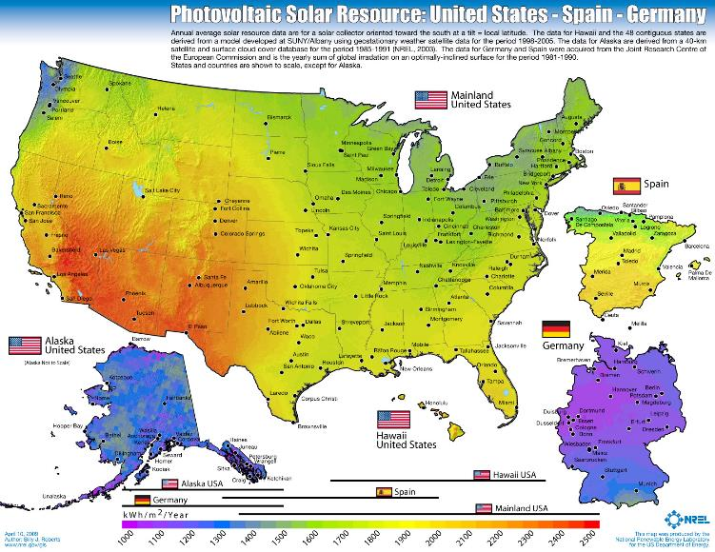
US has tremendous solar resource relative to current leading solar markets
Slide 14

Slide 15
FITs Drive All Renewables
15
Notes:
15

Slide 16
Get FIT to Win
Municipalities
  Gainesville launched a Solar FIT in early-2009
  Sacramento launched a massive FIT program in early-2010
  San Antonio launched a Solar FIT in June 2010
  Los Angeles expected to enact a major Solar FIT in coming months
  Many additional municipalities are in process
States
  Vermont enacted the first statewide FIT in mid-2009
  Ontario Canada launched a massive FIT in November 2009
  Renewable Energy & Economic Stimulus Act (REESA FIT) in California
  Many additional states are in process
National
  HR5883 (Inslee) introduced on 27 July 2010
www.fitcoalition.com
16

Slide 17
REESA FIT = Economic Win
Report by UC Berkeley (Professor Dan Kammen and Max Wei) shows unparalleled economic boost to California from the REESA FIT as compared to the central station baseline case for achieving the 33% RPS by 2020
The REESA FIT will generate three times more jobs, which means an additional 28,000 direct jobs per year in California between now and 2020
With multiplier effects, stimulation of massive levels of indirect and induced jobs as well
Investment and tax revenue increases are directly correlated to employment
The REESA FIT drives three times more jobs in California than the baseline approach for fulfilling the 33% RPS

Slide 18
Ratepayers SAVE Money
The REESA FIT in California delivers 5% in ratepayer savings while fulfilling the entire 33% RPS on schedule!!!
 |  | FiT Rate ($/kWh) |  | Annual cap limit (%) |  | Avoided Cost ($/kWh) |  | Annual FIT rate degression (%) | Annual escalator for avoided cost (%)
 |  | $ 0.16 |  | 2 |  | $ 0.125 |  | 5 | 3
 | Total CA Electric | FIT Rate | Cumulative | Quantity | FIT Fulfillment | FIT Cost | Avoided Cost | Avoided Cost | Rates | Rates | Rate Differential
Year | Energy (GWh) | ($/kWh) | Limit | (GWh) | of RPS | ($mil) | ($/kWh) | ($mil) | without FIT | with FIT | baseline premium w/ FIT
2011 | 267,665 | 0.160 | 2.00% | 5,353 | 2% | 857 | 0.125 | 669 | 0.138 | 0.139 | 0.51%
2012 | 268,349 | 0.152 | 4.00% | 10,734 | 4% | 1,674 | 0.129 | 1,382 | 0.139 | 0.140 | 0.78%
2013 | 268,960 | 0.144 | 6.00% | 16,138 | 6% | 2,455 | 0.133 | 2,140 | 0.141 | 0.142 | 0.83%
2014 | 269,500 | 0.137 | 8.00% | 21,560 | 8% | 3,199 | 0.137 | 2,945 | 0.142 | 0.143 | 0.66%
2015 | 269,969 | 0.130 | 10.00% | 26,997 | 10% | 3,907 | 0.141 | 3,798 | 0.143 | 0.143 | 0.28%
2016 | 270,365 | 0.124 | 12.00% | 32,444 | 12% | 4,581 | 0.145 | 4,701 | 0.144 | 0.144 | -0.31%
2017 | 270,690 | 0.118 | 14.00% | 37,897 | 14% | 5,223 | 0.149 | 5,656 | 0.145 | 0.144 | -1.10%
2018 | 270,943 | 0.112 | 16.00% | 43,351 | 16% | 5,832 | 0.154 | 6,665 | 0.147 | 0.144 | -2.09%
2019 | 271,124 | 0.106 | 18.00% | 48,802 | 18% | 6,411 | 0.158 | 7,728 | 0.148 | 0.143 | -3.29%
2020 | 271,234 | 0.101 | 20.00% | 54,247 | 20% | 6,960 | 0.163 | 8,847 | 0.149 | 0.142 | -4.66%
Source: CPUC, FIT Coalition

Slide 19
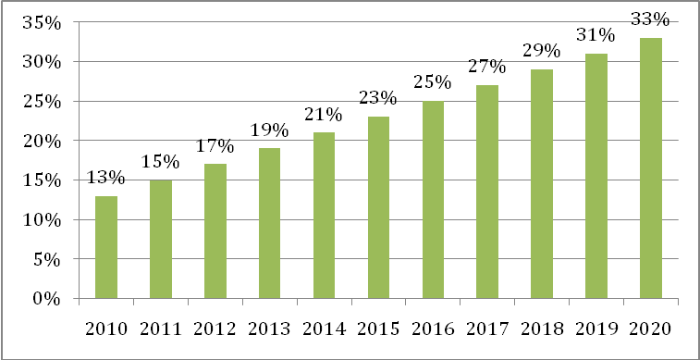
Getting it Done Right, Finally
Renewable Energy & Economic Stimulus Act (REESA)
Makes the 33% RPS real, on schedule, and reduces rates for ratepayers
Source: FIT Coalition

Slide 20
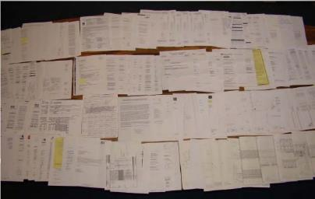
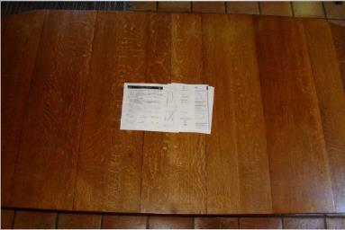
FITs are Refreshingly Simple
FITs are the Easy Choice
Parasitic Transaction Costs & Parasitic Transaction Time are Near-Zero
Typical California paperwork for one project
Typical Germany paperwork for one project
Could be a 1kW-sized project, but maximum 1MW (via CSI program). Even more paperwork for California projects larger than 1MW (via RPS program).
Could be a 1kW or 20MW-sized project, or bigger.
Source: Gary Gerber, President of CalSEIA and Sun Light & Power, Jun09
Parasitics can easily add 10% on the ratepayer for California projects vs German ones
20

Slide 21
FITs Make the Solar Industry
Backup
21

Slide 22
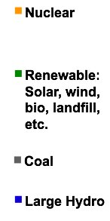
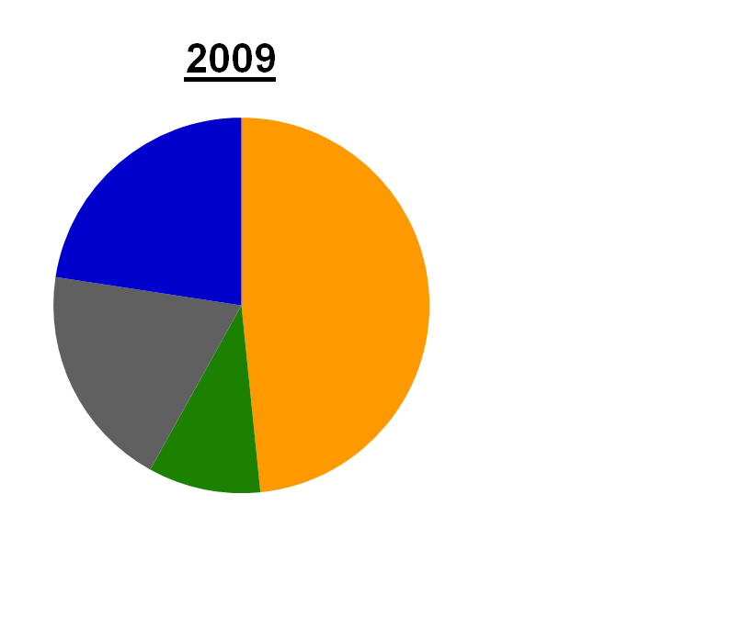
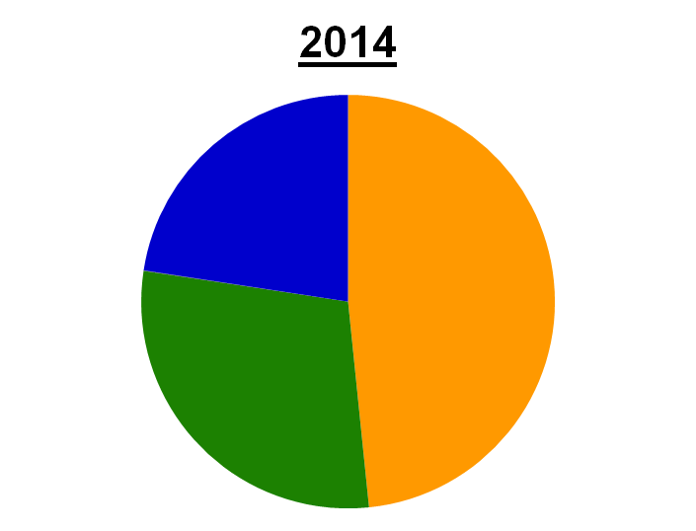
FIT Deliver on Renewables Goals
Ontario Goal to Replace 100% of Coal Power by 2014
6 GW
Coal power
Note: The Canadian Province of Ontario had 31 GW of peak electric capacity in 2009.
6 GW of coal power on track to be replaced by renewables over 5 years

Slide 23
HR5883 - National FIT Bill
HR5883 introduced on 27 July 2010
  Introduced by Congressman Inslee with four original co-sponsors: Reps Delahunt, Grijalva, Honda, and McCollum
Modeled after successful European FIT programs
  Standard contract set by FERC
  Expedited priority interconnect (< 10kw, <2MW, SGIP)
  Cost-based rates originally set at 70th percentile of resource quality, then annual degression and/or analytical adjustments
  Target 8 percent return over 20 years
  Bonuses for congestion, peak, CHP, tribal
Regional cost-sharing & reimbursement
  System benefits charge collected by national corporation
  Reimburse utility costs, including network upgrades and premiums over avoided cost
  Relief for energy intensive industries

Slide 24
Putting it Together in Palo Alto

Slide 25
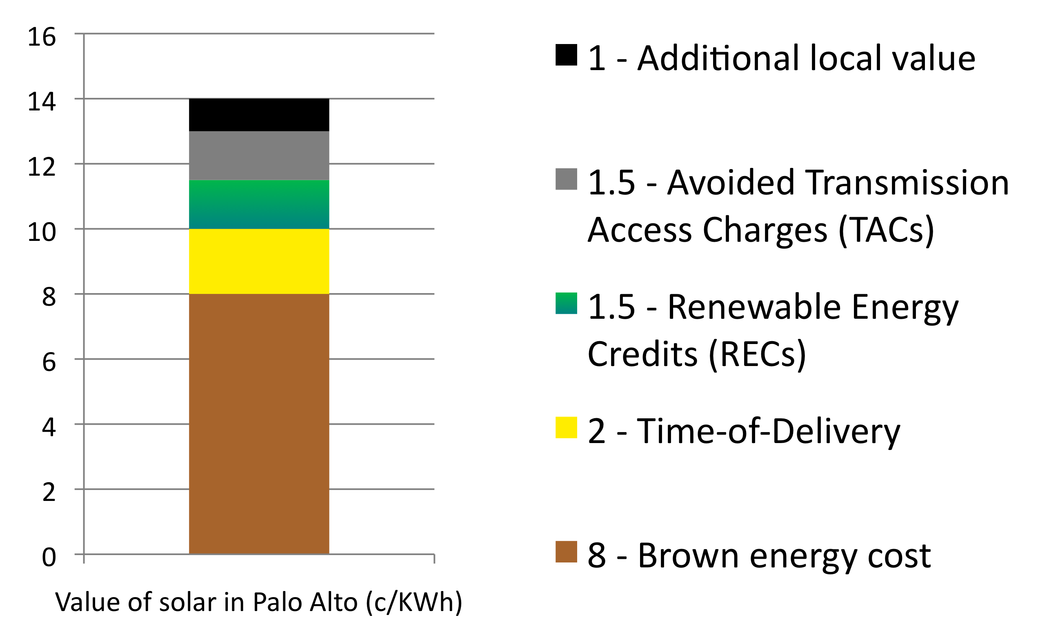
Avoided Cost can be Surprising
Notes:
Locally produced PV includes direct financial value beyond the baseline cost of energy, including production of power where its needed and when its needed - during peak demand without transmission requirements, and tradable Renewable Energy Credits that are transferred to the wholesale purchaser under a FIT program. It is important to evaluate the cost of a program to the next best alternative. Since solar produces energy when it is most valuable, during peak demand periods, it must be compared to the generation sources which would otherwise be used at these times. Peaker plants are used to provide peak-period energy and are the most appropriate alternative option; and they are expensive!

Slide 26
WDG FITs Deliver Trifecta
* Electricity price + Tradable Green Certificate (i.e. REC)
Sources: NREL 2009; BMU 2008; EUROSTAT 2008; ISI, 2008; Fouquet, D. et al., 2008.
26

Slide 27
Key Definitions
DG = Distributed Generation
  Retail DG (RDG)
    Behind-the-meter
    Net metered
  Wholesale DG (WDG) has some basic attributes
    Wholesale (all energy sold to the utility)
    20MW-and-under
    Distribution-interconnected (close-to-load, but not behind-the-meter)
PPA = Power Purchase Agreement
  Energy purchasing agreement between electricity generator and customer
FIT = Feed-In Tariff
  Pre-defined, pre-approved PPAs between renewable energy generators and utilities
  Most effective policy in the world for getting cost-effective renewables online
  Simple, fair, and effective
RPS = Renewables Portfolio Standard
  A renewables target: a percentage of total delivered energy by a specified date
WDG market size
100 times larger than
RDG market size

Slide 28

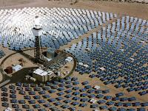


Project Size Market Segments
Size
Central Station, Transmission-Interconnected
~20 MW-and-larger
Wholesale DG, Distribution-Interconnected
<20 MW
Retail DG
<1 MW
Segment
Urban and
Distribution grid
Rural and
Transmission grid
Notes:
A feed in tarriff could harness the most cost effective solar power if it is properly designed.
This diagram show the relationship between small scale and large scale solar power projects and whether these projects are within urban boundaries to capture medium to large scale projects which could be built on mutli-famliy homes, businesses and public buildings.

Slide 29

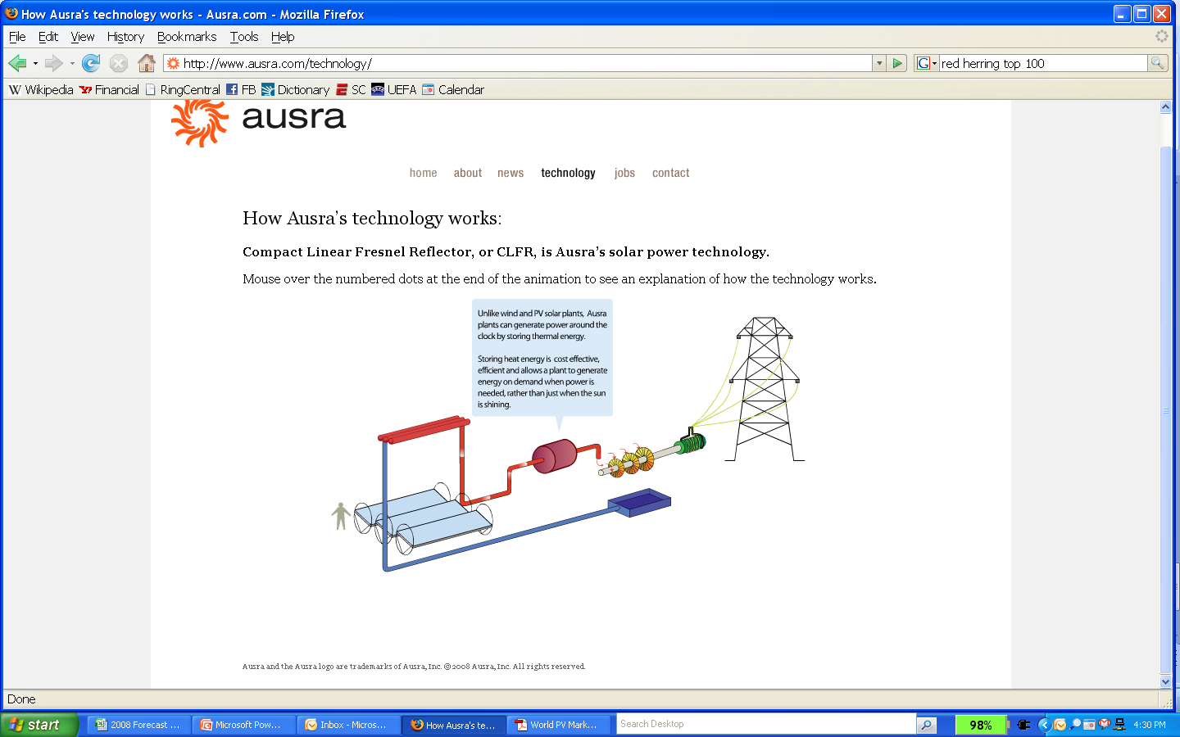

Why California is Failing
Gap in Programmatic Support
WDG
1MW-to-20MW
CSI/SGIP Prog
Net metering
behind-the-meter
RPS Program
Large transmission-
interconnected projects
Program Effectiveness
AB1969 FIT
RPS
(small)
SCE SPVP
SCE Biomass
Program
1MW-and-under
20 MW-and-above
Project Size
(MW, quasi-logarithmic)
0
1
1.5
10
20
29

Slide 30
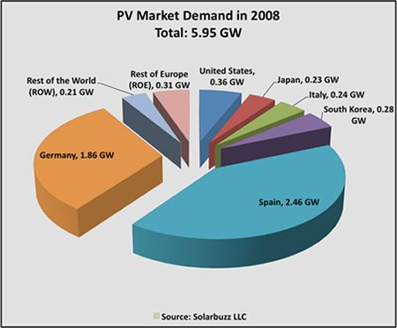
RDG/Net Metering Fails to Deliver
MW
RDG does not drive volume, nor does it satisfy RPS requirements
30

Slide 31
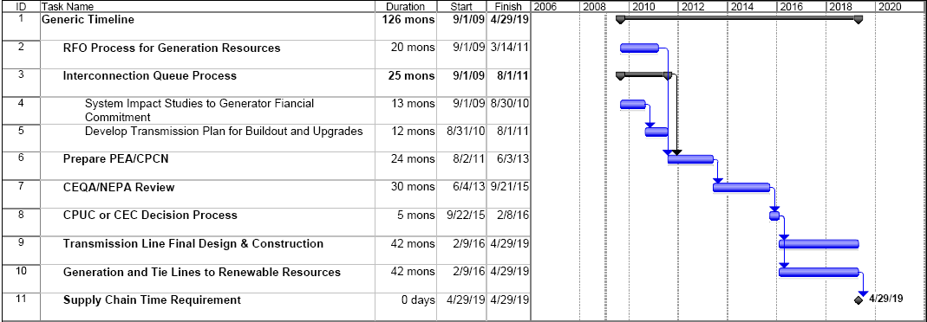
Central Station Fails to Deliver
Shortest Conceivable Timeline for Transmission Build is 10 years
Build-outs require 10 years IF everything goes smoothly
no supply chain or financial barriers
no environmental or litigation barriers
CPUC estimates: For 33% RPS in 2020, 7 new transmission lines costing $12 Billion
Source: CPUC-commissioned E3 analysis, Jan09
31

Slide 32

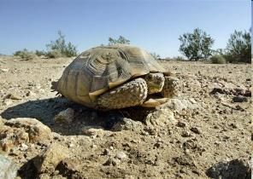
Some Transmission is Impossible
“SMUD has been trying to get new transmission lines approved, but people are coming out in droves against it. We’ll get two to three hundred people coming out in small towns of that same population.”
-- Obadiah Bartholomy, Sacramento Municipal Utility District

Slide 33
WDG: The Big Opportunity
WDG = Wholesale Distributed Generation
  Wholesale (all energy sold to the utility)
  20MW-and-under
  Distribution-interconnected (close-to-load, but not behind-the-meter)
WDG provides significant Locational Benefits (LBs) value
  In CA - distribution-interconnected generation 35% more valuable than transmission-interconnected
  At the very least, WDG is worth 15% more that transmission-interconnected generation, because it avoids Transmission Access Charges (TACs) of ~1.5 cents/kWh that is paid to CAISO for energy off the transmission grid
WDG potential: hundreds of GWs
  Whole CA system is 60GW at peak
  California Energy Commission RETI Phase 1B resource report identified 27.5GW of PV potential alone, looking only at 20MW projects on non-sensitive160 acre parcels that are adjacent to distribution substations
Every successful FIT in the world is a WDG FIT

Slide 34
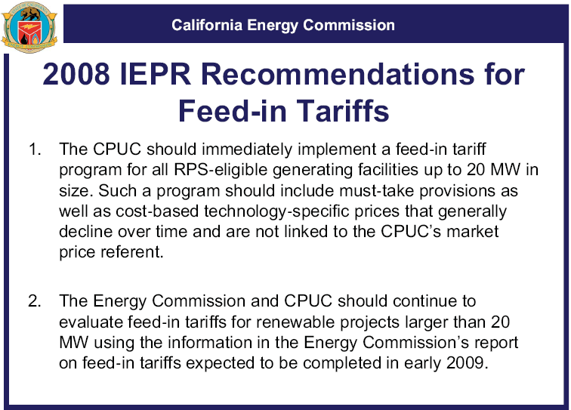
CEC: Unleash WDG Now
Official CEC recommendation, released 1 Dec 08
34

